Slide 1
Design-Build Processes Training Module
Notes:
Welcome to the Design-Build Processes Training Module which is the third a training sessionmodule within the NAVFAC Design-Build (DB) Training Series.
This Design-Build training series consists of training modules that provide an understanding of the latest Design-Build policies and processes and an explanation of the tools and documents available to help our NAVFAC personnel and Design-Build Teams accomplish their jobs.

Slide 2
Design-Build Training Series
DB training modules describe NAVFAC Design-Build policies and processes and an explanation of the tools and documents available.
Introduction to Design-Build
Standard RFP Template
Design-Build Processes
Small Project Template
D-B Master Management Training for Criteria Managers
The NAVFAC Construction manager training series provides the information to effectively manage NAVFAC Construction Contracts. These modules are accessed through Total Workforce Management System (TWMS).
DB Modules in that series:
NAVFAC CI Design-Build Post Award Process
NAVFAC CI Post Award Kickoff Meeting (PAK)
Notes:
Slide 2 (inserted new slide)
The training modules provide Project Manager and Designers with the details for the DB processes, explanation of the level of design required, the unique post-award processes as well as roles and responsibilities. The goal of the training series is to prepare you to leverage DB to its fullest advantage.
There are five modules:
• Introduction to Design-Build
• Standard RFP Template
• Design-Build Processes
• Small Project Template
• D-B Master Management Training for Criteria Managers
A training series to provide NAVFAC Construction Managers with basic and fundamental information required to effectively manage NAVFAC Construction Contracts is available. These training modules can be found in the Total Workforce Management System (TWMS). Select Online Training & Notices then Available Training. Scroll down to the course titles that begin with NAVFAC CI. The modules that deal specifically with DB are the Design-Build Post Award Process and Post Award Kickoff Meeting (PAK) modules.

Slide 3
Course Navigation
Course Length: Approximately 50 Minutes
Module Contains Knowledge Check Questions
Notes:
This course is approximately 50 minutes long.
There are Knowledge Checks throughout the course to test your comprehension.
(Added a screen shot to slide to better illustrate the navigation)
Each page of this course contains a navigation bar across the bottom.
The course will not move to the next page automatically – Use these buttons to move within the course.
Click the play or pause button to play or pause the course.
Click the back button to review the previous page
Click the forward button to go to the next page
Click and drag the progress indicator to move the course forward or backward
Click the audio button to turn the audio on or off
Click the exit button to close the course window
Click the arrows at the top left corner to pen or close the table of contents.

Slide 4
Learning Objectives
Get Familiar with Characteristics of the 4 Design-Build Processes
Know the Commonalities and Differences between the 4 Design-Build Processes
Understand the Design-Build Team Make-up
Learn About the NAVFAC Business Management System (BMS)
Understand BMS Roles and Responsibilities
Know the Post-award Processes
Notes:
These are the topics and learning objectives for this training module.
First, to know the Commonalities and Common Objectives of the 4 NAVFAC Design-Build Processes
Understand the Make-up of the Design-Build Team on a NAVFAC project
Learn about the NAVFAC Business Management System, or BMS
Understand the NAVFAC personnel Roles and Responsibilities as outlined in the BMS
Get familiar with the Characteristics of the 4 NAVFAC Design-Build Processes
And finally, know the Post-award Processes

Slide 5
Design-Build Processes
NAVFAC’s Design-Build processes:
Standard Design-Build Process
Standard Design-Build, In-House RFP Development
Standard Design-Build, A-E RFP Development
Multiple Award Construction Contract (MACC) DB Process
Sole Source Negotiated Scope DB Process
Small Project DB Process
Notes:
NAVFAC has four basic Design-Build Processes. All four have a specific purpose. Which of these processes are chosen to efficiently execute the project depends on the size and complexity of the project. Risk and the associated acceptance level of that risk must also be considered when choosing a process.
The four processes are:
The Standard Design-Build Process, which can be used for all NAVFAC projects although it is typically used in larger stand-alone contracts.
Multiple Award Construction Contract, or “MACC”, Design-Build Process which is used for task orders executed under a MACC Contract.
The Sole Source Negotiated Scope Design-Build Process which is used with non-competitive contracts, and
The Small Project Design-Build Process which is used for small, low complexity projects.
It is important to note that these processes have been developed and refined in the last 20 years of NAVFAC performing Design-Build projects. These processes have been shown to yield successful projects when followed by all parties and accompanied by open communication and collaboration among all parties.
We are going to describe each of these design-build delivery processes, but before we do let’s talk about what they have in common…

Slide 6
Business Management System (BMS)
NAVFAC’s Business Management System
Documents all NAVFAC processes
Web-Based tool accessible on NAVFAC Portal
BMS are continually being updated
Always a work-in-progress
Allows input for continuous improvement
Review regularly for updates to processes
Notes:
You can find the steps to ensure successful project delivery and much more in NAVFAC’s Business Management System, or “BMS”.
Most of you know that BMS is a system that outlines NAVFAC’s business processes and describes the work performed to deliver NAVFAC products and services. It includes associated resources and identifies roles and responsibilities for NAVFAC personnel.
The BMS system is web-based and is accessible through the NAVFAC portal. These processes are not accessible to non-NAVFAC personnel.
The BMS processes are designed to be continually updated so they should be reviewed regularly to determine if any processes have been updated

Slide 7
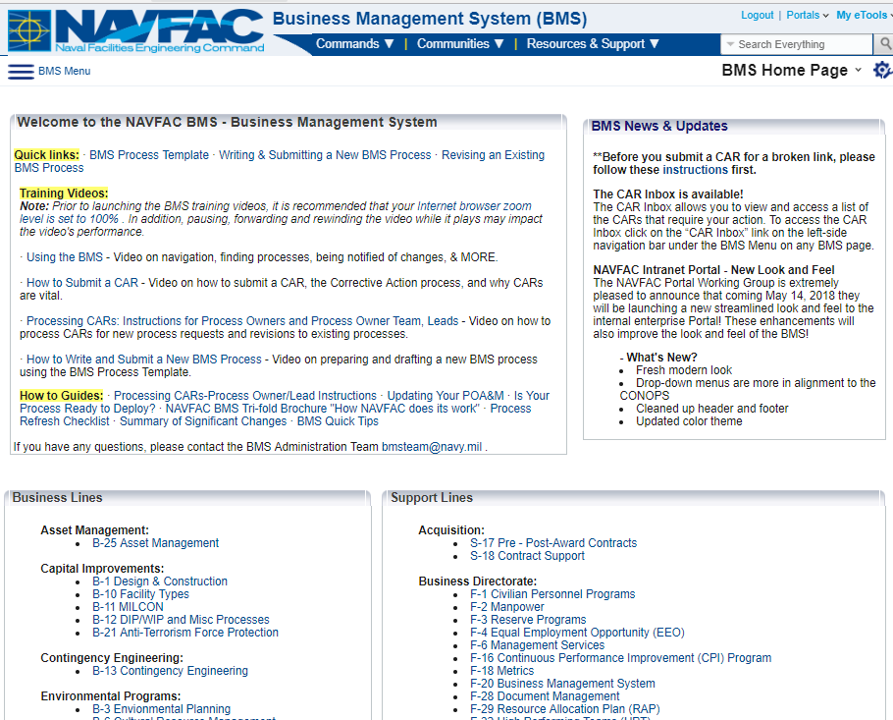
Design-Build and BMS
NAVFAC Employees Access BMS from the
NAVFAC Portal Intranet
Under “eTools”
BMS Home Page
Links to all Process Groups
Frequently Asked Questions
BMS Tutorial & Intro
How processes are organized
How to submit a CAR
Notes:
The BMS is accessed through the NAVFAC Portal Intranet. Unlike the NAVFAC Design-Build Master RFP that is housed on the public Whole Building Design Guide website, BMS is internal and not accessible to the public.
The Capital Improvement Section of BMS addresses several processes. B1 section of the BMS, titled “Design and Construction”, includes both Design-Bid-Build and Design-Build processes. Note that Capital Improvements has a specific page link.
The Acquisition Section of BMS that addresses the planning, award and administration of design and construction contracts is in BMS Section S-17.

Slide 8
Design-Build – Processes Covered in BMS Sections
BMS Sections for Processes by Procurement Type:
Procurement Method | BMS Process Section
Standard Design-Build, In-House RFP Development | B-1.4.1
Standard Design-Build, A/E RFP Development | B-1.4.2
Multiple Award Construction Contract (MACC) Design-Build | B-1.4.3
Sole Source Design-Build | B-1.4.4
Small Project Design-Build | B-1.4.5
Notes:
This list shows the sections of the BMS that cover the Design-Build processes. These sections cover NAVFAC personnel’s roles and responsibilities for successful delivery of a Design-Build project, based on each procurement method.
Under B-1.4 you would see these processes:
B-1.4.1 covers Standard Design-Build with In-House RFP Development
B-1.4.2 covers Standard Design-Build with A/E RFP Development
B-1.4.3 outlines Multiple Award Construction Contract, or MACC Design-Build (for task orders)
B-1.4.4 covers processes for Single-Source Negotiated Scope, and
B-1.4.5 outlines the Small Project Design-Build Decision Process

Slide 9
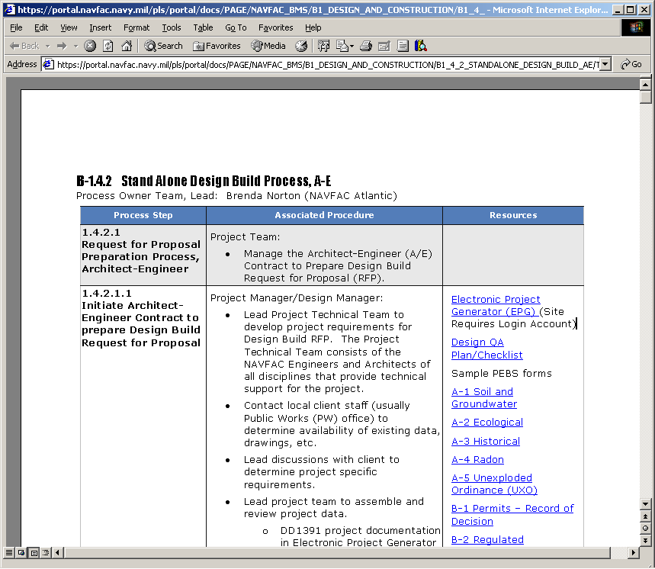
BMS Process Details
Process Details
Outlines the “Role”
Outlines the “Responsibility” with full description of
“how to do the work”
Links to forms, templates,
checklists, laws, policies,
regulations, instructions,
web sites
Cross-functional knowledge via inter-process links e.g., Financial Mgt, Acquisition
Notes:
Here is an example of the detail in BMS :
BMS outlines the role and responsibility of a NAVFAC team member,
For each NAVFAC team member it describes the effort needed and how they should do the work,
The BMS conveniently provides links to resource documents and forms needed to complete the various tasks within the process steps.
Some of these links provide cross-functional knowledge, such as to related BMS processes covering financial management and acquisition processes that are specific to Design-Build

Slide 10
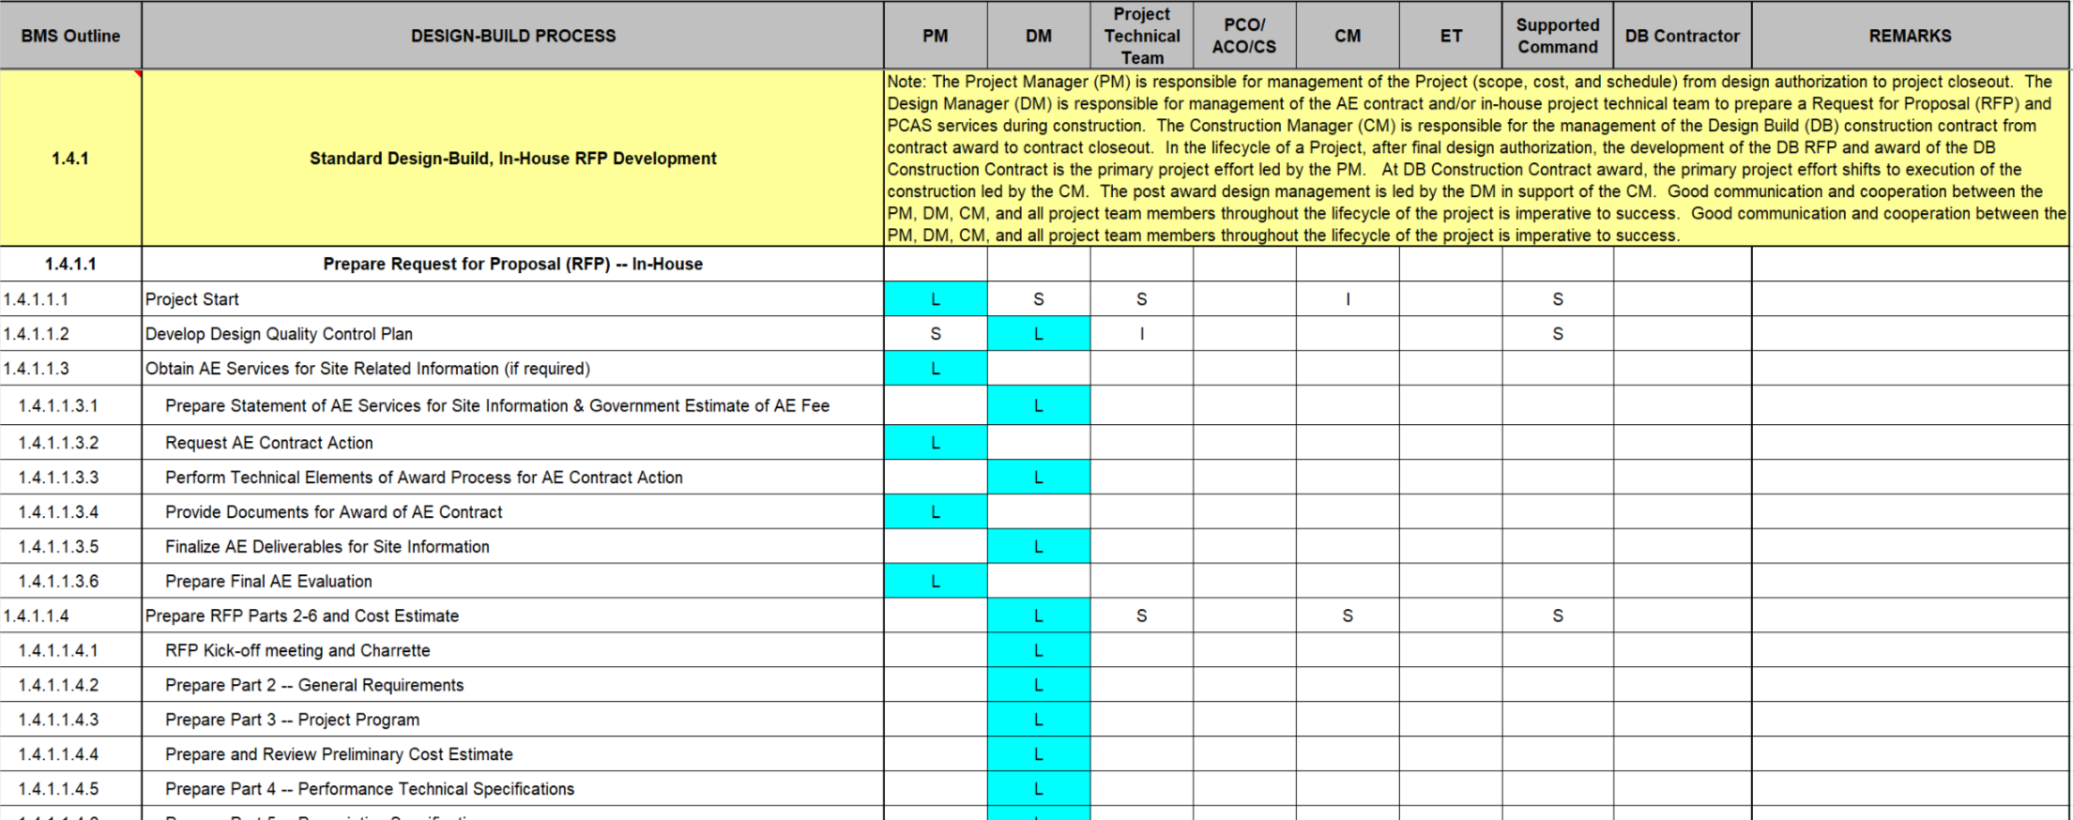
Design-Build – Pre-Award Process
BMS Roles and Responsibilities Matrix unique to DB
Notes:
BMS also includes a matrix presentation of the roles and responsibilities of NAVFAC personnel in these processes. NAVFAC personnel, in their project roles as Project Manager, Design Manager, Construction Manager or Engineering Technicians may be shown as “Leading” a task, indicated with an “L”; “Supporting” a Task, indicated with an “S”, or providing “Input”, which is indicated with an “I”.
As seen in the matrix here, the project team includes the PM, CM, Contract Specialist (CS), DM, Project Technical Team, Supported Command, and others as appropriate.
The Roles and Responsibilities (R&R) Matrix is provided as a companion to assist in the project delivery process. It should not be used independently of the fully developed processes as outlined in the BMS’s.
These processes and associated roles and responsibilities have been developed to ensure successful project delivery and all NAVFAC personnel should be familiar with their expected responsibilities for each process in the Design-Build project approach.

Slide 11
Design-Build – NAVFAC Personnel Roles
Roles and Responsibilities Matrix in BMS
Defines responsibilities for Government personnel on DB projects
Key NAVFAC Personnel
Project Manager (PM) – Responsible for management of project (scope, cost, and schedule) from design authorization to project closeout. Relinquishes project lead to CM after award
Design Manager (DM) – Manages A/E Contract, or in-house project team, for development of RFP and leads the review effort of DB Team’s design
Construction Manager (CM) – Leads project beginning at award through close-out
Notes:
This slide shows the general roles of NAVFAC personnel in the Design-Build project delivery process.
The Project Manager is the one with overall responsibility for management of the project all the way through closeout, although for some of the project sub-tasks one of the other NAVFAC team positions takes the “Lead” role in support of the PM.
The Design Manager, or DM, manages development of the RFP, whether through an in-house team or by an A/E Contract. The DM also coordinates or leads the review effort of the Design-Build Contractor Team’s design.
The Construction Manager, or CM, shifts into the “Lead” role in support of the PM beginning at contract award through project close-out.
NAVFAC Engineering Technicians, or ET’s, provide quality assurance during construction by performing periodic reviews.
Good communication and cooperation between the PM, DM, CM, and all project team members throughout the lifecycle of the project is critical to a Design-Build project’s success.

Slide 12
Knowledge Check #1
Notes:
Let’s answer a couple of questions on the material we’ve learned so far…

Slide 13
Knowledge Check #1
The BMS Processes can be accessed from which of the following locations?
Whole Building Design Guide website
NAVFAC Portal
NAVFAC Atlantic website
NAVFAC Pacific website
(True/False) NAVFAC’s Project Manager is only responsible for management of the project from design authorization until award to the DB Contractor, when the Construction Manager takes over?
False. The CM does take the lead role from award through close-out; however, the PM maintains responsibility for management through project closeout.
Notes:
[Answer lines will be revealed using animation when audio-video versions are created]
Question number 1: The NAVFAC Business Management System processes can be accessed from which of the following locations. “a”, the Whole Building Design Guide website, “b”, the NAVFAC Portal, “c”, the NAVFAC Atlantic website, or “d”, the NAVFAC Pacific website
The answer is “b”, NAVFAC employees access BMS from the NAVFAC Portal Intranet
Question number 2, True or False: NAVFAC’s Project Manager is only responsible for management of the project from design authorization until award to the Design-Build Contractor, when the Construction Manager takes over…
The answer is “False”. Even though the CM takes the lead role from the point of award through construction closeout, the PM maintains responsibility for management, which includes project scope, cost and schedule.

Slide 14
Common Components
All four processes:
Use NAVFAC standard 6-part RFP format
Use Uniformat Work Breakdown Structure (WBS) to define systems and materials
Use the same Team structure
Use Performance Based requirements – minimizing prescriptive requirements as much as possible
Notes:
With regard to format…
All of these processes use the NAVFAC standard 6-part RFP format
All of the RFP’s used should be as performance-based as possible, and any unnecessary requirements may hinder the delivery of a design-build project
Many Architects and Engineers are accustomed to converting requirements to real solutions so RFP writers often like to go ahead and make all the choices; however, in design-build it is a little different approach. Remember that the Contractor’s Designer of Record is the designer on the project, and the Designer of Record has the advantage of being able to collaborate with the entire Contractor team. Thus, in order to get the benefits of the Design-Build collaborative team, the RFP writer needs to tell the Contractor what is needed but not how to accomplish it. The RFP should not unnecessarily restrict the Contractor by specifying the exact way to construct the project. By limiting the RFP parameters to WHAT is needed, this should open up the Contractor to proposing innovative solutions.
A final commonality for all NAVFAC Design-Build processes is that RFP Parts 3 and 4 utilize the Uniformat Work Breakdown Structure to define the systems and materials for a design-build project

Slide 15
Differences
The main differences between the processes are:
The contents of Part 2, 4, and 5
The procurement process
Stand Alone Contracts
Multiple Award Construction Contracts (MACC)
Sole Source (8(a), JOC, etc.)

Slide 16
NAVFAC DB PROCESSES
Contract Type
Develop
Scope, Budget &
Schedule
Develop RFP
Contract Procurement
Design-Build
the Project
Stand Alone
MACC
Sole Source
KTR Proposal 5%-15% Design
Contract
Award
RFP Issued
Gov’tt RFP Development
KTR Design
Build
Standard DB
KTR Proposals
0% Design
RFP Issued
MACC
Gov’t RFP Development
KTR Design
Build
MACC DB
Small Project
KTR Proposal
Approximate 15%Design
RFP Issued
Sole Source
Gov’t RFP Development
KTR Design
Build
Sole Source Negotiated
Small Project
NOTE: This slide depicts process, not a timeline

Slide 17
NAVFAC DB Master Format
Contract Documents
PART 1
PART 2
General Requirements
PART 3
Project Program
PART 4
Performance Technical Specifications
PART 5
Prescriptive Specifications
PART 6
Attachments

Slide 18
Common Objectives of NAVFAC Design-Build Process – Team Structure
DB Contractor’s
A-E DOR
DB Contractor’s
Major
Subcontractors
Design-Build
Prime Contractor
The Entire
Design-Build
Project Team
DB Contractor’s
Major Suppliers
NAVFAC
ACQ / PM / DM
End User
NAVFAC
CIBL Tech Staff
Support Command
Project Sponsor
NAVFAC
FEAD Staff
Notes:
.

Slide 19
NAVFAC Project Team
Project Manager (PM)
Design Manager (DM)
Construction Manager (CM)
The NAVFAC DB
Project Team
Contract Specialist (CS)
Project Technical Team
Engineering Technicians (ET)

Slide 20
Standard Design-Build Processes
Processes outlined in BMS B-1.4.1 (for in-house RFP’s) and B-1.4.2 (for A/E developed RFP’s)
Versatile/Flexible Process
Uses 6-Part format from NAVFAC DB Master RFP Website
Utilizes Standard Template or a Model RFP
RFP scalable to project
Uses UFC Criteria for design requirements
Typically used for Standalone Contracts
Refer to DB Training Model 2, Standard RFP Template, for details on the content required in each of the 6-parts.
Notes:
The Standard, or Standalone, Design-Build Processes are covered in BMS Sections B-1.4.1 and B-1.4.2, depending on whether the RFP is developed in-house or through use of an outside A/E firm.
The Standard Design-Build Procurement Method:
First, it utilizes a standalone Contract, and is not a task order within an IDIQ Contract or a MACC Contract
Second, it is a very versatile and flexible process, and can be used on any type of project and with any procurement method
It uses the standard 6-part format from the NAVFAC Design-Build Master RFP website; and utilizes either the standard template or one of the Model RFP’s
The RFP is “scalable”; for example, extra information may be needed in the Part 3 Project Program if it is a large complex project with many features; likewise, the RFP can be scaled down for very straightforward projects with fewer disciplines or trades involved
The standard RFP relies heavily on the Unified Facilities Criteria, or UFC, documents for the project design requirements
The “Contract to budget” or estimated construction cost amount may be provided in the RFP on the proposal form in Part 1. If the RFP is in-depth with well-defined requirements, and the project type is repetitive, including the project budget amount may not be necessary. However, with a unique project with requirements that are more performance-based and where the teams have some leeway in their designs, it may make sense to include the project budget amount so that proposals are received within an amount that can be awarded. The decision to list the Contract to budget amount should be based on the project requirements and the MACC Contractor pool that is available; if the MACC Contractors have prior experience with the same type and size of project then the budget information is not as critical a piece of information.
And the standard processes utilize a 2-phase source selection process, with price and non-price technical factors used in evaluation and selection

Slide 21
MACC Processes
Multiple Award Construction Contract Processes outlined in BMS B-1.4.3
RFP issued where a suitable MACC is in place
Uses same 6-Part format from NAVFAC DB Master RFP
Well-defined Project Program, Part 3
RFP may be developed in-house or by A/E
The Base MACC Contract establishes RFP Parts 1 and 2 (Divs 00 and 01); for follow-on task orders, Parts 1 and 2 are only edited for unique location and project requirements
Notes:
The MACC Design-Build Processes are covered in BMS Section B-1.4.3. There is both a regular MACC RFP approach as well as one for projects deemed as “low risk”.
The MACC Processes are very similar to the standard processes, although it uses the MACC Contracts for source selection.
The MACC processes are only used where there is a suitable MACC in place, for example there may be a MACC for Bachelors Quarters or Dining Halls, and this may be the type of facility you need completed through Design-Build. You cannot use a Design-Build project using these processes to set up a new MACC, because this process does not use 2-phase source selection; it only uses 1-phase.
MACC uses the same 6-part format from the NAVFAC Design-Build Master RFP
Because the MACC Contract will be based on certain facility types, the RFP used will have a well-defined Project Program with in-depth scope requirements for that facility type. This will be well-defined because you will be instructing Contractors that have been selected to construct these types of facilities.
RFP’s may be developed using in-house teams within NAVFAC or through use of an outside A/E firm
With these MACC Contracts, the “Base” contract will include Parts 1 and 2, which are the Division 0 and Division 1 sections of the RFP. Then, for follow-on task orders, only the portions of Parts 1 and 2 that are unique to the location or project requirements are included in the task order RFP.
As described for the standard RFP processes, the “Contract to budget” amount or estimated cost of construction may be included in the RFP
And finally, for a traditional MACC (not a low risk MACC) a concept design will be developed by the Design-Build teams and these will be evaluated for selection

Slide 22
Layout of the MACC RFP Package
Notes:
[Graphic to be upgraded during development of upcoming audio-video version]
As mentioned in the previous slides, the MACC RFP Package is typically a scaled-down version of the standard RFP:
First, as described previously, Parts 1 and 2 are issued with the MACC Base Contract, so the Parts 1 and 2 of the project task order RFP would only include those requirements specific to the location or project unique requirements
Part 3 may be scaled back from a standard RFP if the project is a type that the entire MACC Contractor pool has experience with constructing.
Also, if the project is a common facility type then Part 4 for this project type may also have been included in the Base Contract. This would obviously need to be confirmed before Part 4 is omitted.
It is important to remember that most project types included within MACC contracts have well-established criteria documents such as UFC’s. If this is the case, the RFP can be scaled back from the typical amount of information in an RFP.

Slide 23
Layout of the MACC Part 1
Notes:
[Graphic to be upgraded during development of upcoming audio-video version]
As mentioned in the prior slides, Part 1 for a MACC Contract is typically scaled back because many of the standard Division 0 sections are included in the MACC’s Base Contract. This will need to be checked to determine what will need to be added for the task order RFP.
Information does not need to be repeated in each MACC task order.
This slide shows the typical layout of a Part 1 section for a MACC RFP. The sections in yellow are typically in the Base Contract and those in blue will typically be customized for each project task order.

Slide 24
Layout of the MACC Part 2
Notes:
[Graphic to be upgraded during development of upcoming audio-video version]
This slide shows the sections in Part 2 of a MACC RFP. Again, the Base Contract will need to be reviewed to determine what needs to be included in each task order RFP. All of these may need to be included in the task order, or most of these sections may be included in the Base Contract and Part 2 of the task order would only need to include edits to the Sections specific to the task order, such as access road or gate requirements, security access information, etcetera.

Slide 25
Sole Source Processes
Sole Source Contract Processes in BMS B-1.4.4
Used with 8(a) Contractors for projects < $4M follow BMS S-17.2.17 for Acquisition
Ensure project matches the Contractor’s skills
Allows for open discussions with Contractor prior to award
Uses the 6-part RFP format
Uses a scaled-down Project Program, Part 3
Existing information is provided in the RFP; Government typically does not perform additional testing. Contractor, during the proposal phase, collects any additional information needed
Notes:
The Sole Source Design-Build Processes are covered in BMS Section B-1.4.4.
The Sole Source processes are used with 8(a) Contractors and on projects less than $3.5 Million. BMS section S-17.2.17 outlines the acquisition procedures for Sole Source; these thresholds change periodically so this BMS should be reviewed for the latest project value threshold
When selecting the Contractor, make sure their skills and past experience are appropriate for the project
This method allows for open and unlimited discussions with the Contractor prior to award; this is very different from the other Contracting methods in Design-Build
The RFP uses the traditional NAVFAC 6-part format; however, the Project Program in Part 3 can be scaled-down, because discussions are held to confirm the scope, and…
If a concept design is not included in Part 6 of the RFP, then the Contractor will submit a concept design in which the proposed scope can be confirmed.
One important distinction in the Sole Source process is that existing site and project information is collected and provided in the RFP; but for this process, the Government typically does not perform any additional testing. The Contractor, during the proposal phase, will be allowed to further collect information such as topographic survey or geotechnical evaluations required as necessary to develop proposal costs. After award, the Contractor will then perform testing necessary to comply with Unified Facilities Criteria (UFC) requirements.

Slide 26
Sole Source Processes
Sole Source Contract Processes (cont’d)
Scope is refined through open discussions and meetings with Supported Commanders and Contractor
Contractor’s proposal will include a concept design and proposed price, evaluated before award
Government develops Cost Estimate independent of Contractor
Post-award – parties continue to review and refine project details during design phase after award
Notes:
Looking at additional characteristics of the Sole Source Negotiated processes…
Through the open discussions and meetings that take place between the client and Contractor in the Sole Source Process, the project scope becomes more refined
Similar to other methods, the “Contract to budget” amount or estimated cost of construction may be included in the RFP
The Contractor’s proposal will include a concept design, typically to about 15% completion of design, as well as a proposed price. These will be evaluated before award. Any features in the concept design can be discussed during negotiations prior to making any award. Much of the discussions during negotiations will center on confirmation of the scope as required by the Government and the client.
Part of the process involves the Government developing a Cost Estimate independent of the Contractor. This will serve as a means of identifying those areas during negotiations that may be causing the differential in the pricing.
Remember that the design concept, and the resulting contract award, was based on approximately a 15% design completion. Thus, after the award, the parties continue discussions to work through many of the details involved in refining the project specifics

Slide 27
Knowledge Check #2
Notes:
Let’s answer a few more questions on the material we’ve learned so far…

Slide 28
Knowledge Check #1
The RFP should be which of the following:
As performance-based as possible
Prescriptive-based, telling the Contractor how to accomplish the project
(True/False) The Government’s Technical Team should be comparing the design to the last successful project they worked on for this same facility type?
False. Should be comparing to the RFP requirements and the Contractor’s proposal.
Notes:
[Answer lines will be revealed using animation when audio-video versions are created]
Question number 1: The Design-Build RFP should be which of the following. “a”, as performance-based as possible, or “b”, prescriptive-based, telling the Contractor how to accomplish the project…
The answer is “a”, as performance-based as possible. Remember that in Design-Build the Contractor’s Designer of Record is the designer on the project, and they have the advantage of being able to collaborate with the entire Contractor team. Thus, in order to get the benefits of the Design-Build collaborative team, the RFP needs to tell the Contractor what we need, in a performance-based manner, but not how to accomplish it. We don’t want to unnecessarily restrict the Contractor in specifying the exact way to construct the project. This allows the Contractor to propose innovative solutions.
Question number 2, True or False: The Government’s Technical Team should be comparing the design to the last successful project they worked on for this same facility type…
The answer is “False”. There may be good reasons for the project requirements to be different from other similar projects; thus, the Technical Team must be comparing the Contractor’s design to the requirements stipulated in the project RFP and also to the Contractor’s proposal that was used as the basis for award.

Slide 29
“Small Project” Process
Different template from the Standard DB Master RFP template
Scaled down version
Does not have the level of detail
Not suitable for all project
Minor renovations or repairs
Single system repair or replacement
Single discipline work, e.g. road repair
Determining suitability is tricky
Can be used with a variety of contract types
Refer to DB Training Model 4, Small Project Template. for details on the content required in each of the 6-parts.

Slide 30
Small Project Design Guidance
Category of Work | Typical Contract Value | Use Small Project Process | Small Project DB Process Suitable for:
I | Any | No | ---
II | > $4M | No* | ---
 | $750K - $4M | Probably (if project meets listed suitability & requirements for SPDB) | Low-complexity, limited construction trade projects requiring routine designs with limited plans & specifications. Routine construction practices with low schedule risk. Typical types of projects include: Single-design or limited design discipline projects such as roof replacements, HVAC replacements, small pump houses, utility enclosures
 | < $750K | Yes | Non-complex
III | Category III work requires no design and is not Design-Build
IV | Category IV work requires no engineering or design and is not Design-Build

Slide 31
Contract Procurement
Design Build Construction Contracts are procured through three main type of contract vehicles.
Standalone Contracts
MACC Task Orders
Sole Source Contracts
Notes:
Two-Phase Design-Build Selection procedures:
a. Are performed IAW FAR 36.3.
b. Are used:
(1) As we stated earlier, these procedures are used when your contract tool is a competed new stand alone contract or basic IDIQ (both MAC and other IDIQs) (including competitive 8(a) acquisitions); and
(2) When determined appropriate per FAR 36.301(b).
So let’s see when it is appropriate:
FAR 36.301(b) says:
Three or more offers are anticipated;
Design work must be performed by offerors before developing price or cost proposals and offerors will incur a substantial amount of expense in preparing offers; and
The criteria in FAR 36.301(b)(3) have been considered.
Let’s take a look at what this criteria is.

Slide 32
Standalone Contracts
FAR Part 36.3 requires the use of a Two-Phase Selection Procedures for Design-Build for competitive contracts.
Two-Phase Selections applies to Stand Alone and the Initial award (basic) for Multiple Award Construction Contracts (MACCs)
Best Value Source Selection Evaluation Methods
Tradeoff Analysis
Guidance and supporting tools provide
Evaluation board structure
Roles and responsibilities of the Technical Evaluation Team
Business Rules on writing a concise findings documentation (report)
Notes:
Two-Phase Design-Build Selection procedures:
a. Are performed IAW FAR 36.3.
b. Are used:
(1) As we stated earlier, these procedures are used when your contract tool is a competed new stand alone contract or basic IDIQ (both MAC and other IDIQs) (including competitive 8(a) acquisitions); and
(2) When determined appropriate per FAR 36.301(b).
So let’s see when it is appropriate:
FAR 36.301(b) says:
Three or more offers are anticipated;
Design work must be performed by offerors before developing price or cost proposals and offerors will incur a substantial amount of expense in preparing offers; and
The criteria in FAR 36.301(b)(3) have been considered.
Let’s take a look at what this criteria is.

Slide 33
Two-Phase Source Selection
Two-Phase Design-Build Selection Procedures
Offers submit proposals and are evaluated in two phases
Phase One (Qualifications):
Phase Two (Technical and Price)
Mandatory Standard Non-Cost/Price Evaluation Factors
Phase I:
Factor 1 – Technical Approach
Factor 2 – Experience
Factor 3 – Past Performance
Phase II:
Factor 4 – Safety
Factor 5 – Technical Solution
Factor 6 – Energy & Sustainable Design
Factor 7 – Small Business Utilization
The Standard Factors and Guidelines on how to use them can be found at
https://hub.navfac.navy.mil/webcenter/portal/ci/page1182/page128/page1473
Notes:
Two-Phase Design-Build Selection procedures:
a. Are performed IAW FAR 36.3.
b. Are used:
(1) As we stated earlier, these procedures are used when your contract tool is a competed new stand alone contract or basic IDIQ (both MAC and other IDIQs) (including competitive 8(a) acquisitions); and
(2) When determined appropriate per FAR 36.301(b).
So let’s see when it is appropriate:
FAR 36.301(b) says:
Three or more offers are anticipated;
Design work must be performed by offerors before developing price or cost proposals and offerors will incur a substantial amount of expense in preparing offers; and
The criteria in FAR 36.301(b)(3) have been considered.
Let’s take a look at what this criteria is.

Slide 34
MACC Task Orders
Task Orders do not require Two Phase procedures
Best Value Source Selection Evaluation Methods
Tradeoff Analysis
Lowest Price Technically Acceptable Process (LPTA)
Price-Only (<$25M)
Evaluation process streamlined
Mandatory Standard Non-Cost/Price Evaluation Factors
Tradeoff Analysis
Factor 1 – Experience (if applicable)
Factor 2 – Past Performance*
Factor 3 – Safety (if applicable)
Factor 4 – Technical Solution
Factor 5 – Sustainable Design
LPTA
Factor 1 – Past Performance
Factor 2 – Project specific requirements (optional)
Notes:
As we discussed earlier in the acquisition planning process, MAC task order selection procedures outlined in FAR 16.505 are to be used for selecting the successful offeror when awarding a task order against an existing MAC. These procedures allow for a much less formal and time consuming selection process than the Two-Phase Selection procedures.
A formal evaluation plan or scoring of offers is not required. Evaluation methodology can be included in the RFP rather than by a separate document or plan.
You do still need to identify
The evaluation method you are going to use to select the successful offeror (i.e., tradeoff process or low price technically acceptable process)
The criteria you will use for evaluating offers – remember to keep submission requirements to a minimum
And, you need to identify the process which you will use to determine the most advantageous offer – should be streamlined. Should not be the formal process identified in FAR 15.3.
- Should use minimal personnel to evaluate proposals
- Should use simplified rating/ranking process
- Not confined to formal discussion/competitive range process

Slide 35
Sole Source Selection Process
For Sole Source selections, follow BMS S-17.2.17
Selection Process
Informal process
Coordinated with Small Business Specialist
Search Construction Contractor Register (CCR)
Match Contractor with project
Capabilities evaluation – check key personnel
Validate past performance with FEAD/ROICC and CPARS
Typical Considerations
Past performance
Past experience –key personnel
Management approach (emphasizes integrated team)
Notes:
BMS section S-17.2.17 outlines the acquisition procedures for Sole Source
The Selection Process is more informal than other processes, however selecting the right Contractor is still critical in order to have a successful design-build project
The first thing to do is to coordinate with the Small Business Specialist
One of the sources for information to identify potential Contractors is the Construction Contractor Register, or the “CCR”; this is a Small Business Administration web-enabled tool that can be searched to locate the Contractors in a particular area; another good source of information is the ROICC office at the Bases in the area – they typically know who the good Contractors are that have worked on their projects; this list of potential Contractors should be maintained somewhere so that it can be referenced for future projects also
To ensure project success it is critical to match the right Contractor with the project…
One of the ways to do that is with a capabilities presentation. A Contractor can be brought in and asked what their experience is on design-build, what is their experience on a particular type of project, and who they might collaborate with on a particular type of project. You need to be careful not to identify the specific project when having these discussions. You are simply trying to get an understanding of their capabilities to determine if they are a good fit for the project. This would involve them having the right people, right experience, and right subs to be able to deliver a successful project
The next thing is to validate past performance by first checking the CPARS system for Contractor evaluations. The CPARS system may not have a lot of information on these smaller Contractors, but you also can talk to the ROICC Office where they might have performed projects for previously. This is an informal process but enables NAVFAC to perform due diligence on identifying the right Contractor.
The typical considerations on selecting the right Contractor include the past performance of the firm, past experience of their key personnel, and their management approach to projects – one thing to focus on here is that they emphasize working with an integrated and collaborative team, including the design team members.

Slide 36
Design-Build – Post Award Process
BMS Post-Award Sections:
Post Award Topic | BMS Process Section
Post Award Design Management | B-1.4.6.1
Schedule for DB Management | B-1.4.6.2
Design-Build Quality Management | B-1.4.6.3
Design-Build Technical Submittals | B-1.4.6.4
Notes:
This table shows the Post-award topics and the sub-sections of BMS section B-1.4.6 that cover these processes specifically for Design-Build. These sections cover NAVFAC personnel’s roles and responsibilities during the post-award design phase, construction phase and all aspects for successful delivery of a Design-Build project.

Slide 37
Post Award Kick-off (PAK) Meeting
The Post Award Kickoff (PAK) meeting is the critical timeframe to collaboratively establish the design schedule and identify all design submittal packages
After award the Government Technical Team:
Is the client’s technical representative and provides input, including lessons learned, to the Contractor’s team
Confirms conformance with the Contract; Technical team should be comparing design to the RFP requirements and Contractor’s proposal
Evaluates the Contractor’s design process (life cycle cost analysis, functional analysis, BIM, etc.)
Notes:
The Project Kick-off, after award, sets the stage for project success…
The Post-award kick-off meeting is a critical component in that it sets the stage for a truly collaborative teaming arrangement and allows the project team to establish the overall schedule, as well as the design schedule, and also to identify all design submittal packages and the procedures that will be used during the post-award design phase
The Government Technical Team has several roles in the project…
First, they are the client’s technical representative and they provide input to the Contractor’s team. The technical team members often have lessons learned on a particular facility type or for work in a certain region of the country, so they can bring this input to the Contractor team
Second, the Government’s technical team is confirming that the Contractor’s proposed design conforms with the contract; this means that the Government reviewers should be reviewing the design against both the requirements outlined in the Design-Build RFP and the Contractor’s proposal that was used as the basis for the Contract award. They should not assume that this facility type has the same needs as the last project they worked on for this same facility type; again, they must review the Contractor’s design against the requirements spelled out in the RFP and the Contractor’s proposal that was the basis for award
Lastly, the technical team must ensure that any requirements included in the RFP with respect to the design process are being met. Examples of these may include life cycle cost analysis of the building or MEP systems, and also BIM requirements.

Slide 38
Design-Build – Post-Award Process
Roles and Responsibilities
Key NAVFAC Personnel – Post-Award
Construction Manager (CM) – Leads Contract Management from construction contract award through contract close-out
Project Manager (PM) – Responsible for management of project (scope, cost, and schedule) from design authorization to project closeout. Relinquishes project lead to CM after award
Design Manager (DM) – leads the review effort of DB Team’s design
Engineering Technician (ET) – Provides quality assurance during construction with periodic reviews.
See BMS B-1.4.6 for Post-Award Processes
Notes:
This list shows the general roles of key NAVFAC personnel in the post-award phase.
As you can see, the roles of the CM and the PM shift after the Contract award to the Design-Build Contractor. While the PM is still the one with overall responsibility for the project all the way through closeout, at project award, the CM shifts into the “Lead” role in support of the PM. The post award design management is led by the Design Manager in support of the CM.
Good communication and cooperation between the Project Manager, Design Manager, Construction Manager, and all project team members throughout the lifecycle of the project is critical to a Design-Build project’s success.
The BMS sub-sections within section B-1.4.6, as listed on the prior slide, cover these post-award processes in great detail.

Slide 39
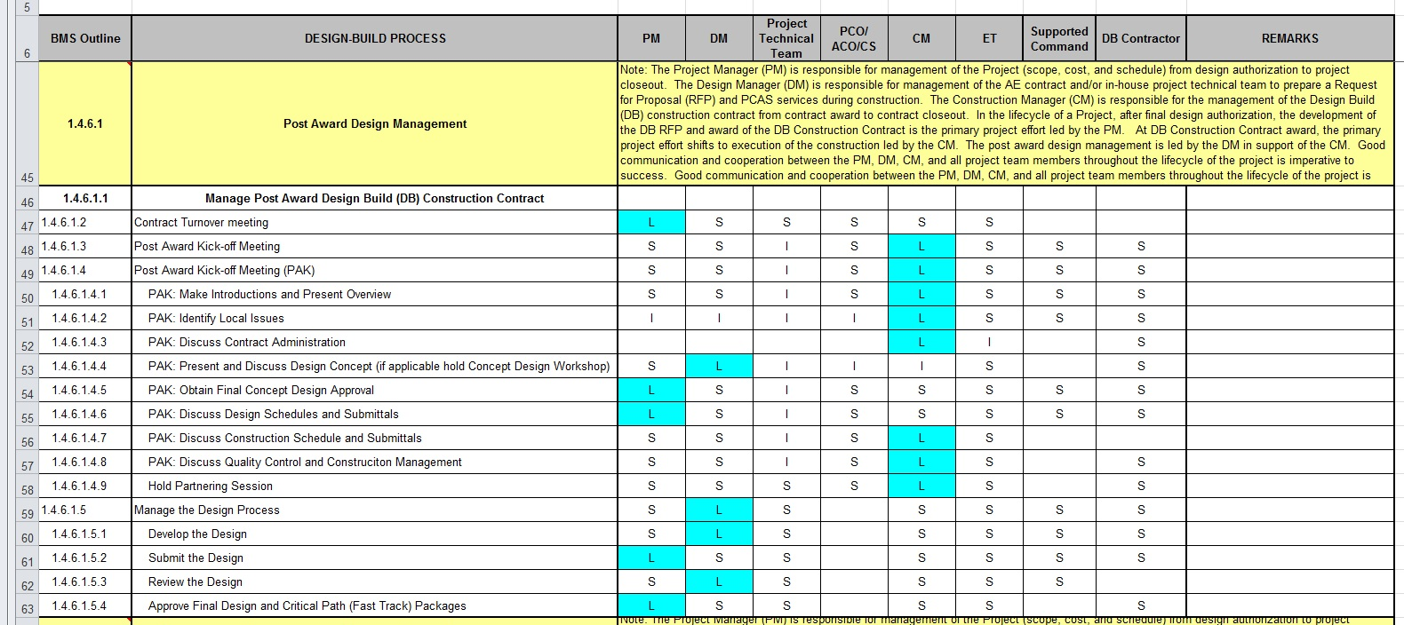
Design-Build - Post Award Process
BMS Roles and Responsibilities Matrix unique to DB
Notes:
Similar to the Roles and Responsibilities Matrix for Pre-Award Processes, the matrix for BMS B-1.4.6 covers the roles and responsibilities of NAVFAC personnel in the Post-award processes that are outlined.
As a reminder, these processes and associated roles and responsibilities have been developed to ensure successful project delivery and all NAVFAC personnel should be familiar with their expected responsibilities for each process in the Design-Build project approach.

Slide 40
Final Knowledge Check
Notes:
Let’s answer a few final questions on the material we’ve learned in this module…

Slide 41
Final Knowledge Check
(True/False) There are separate BMS processes for Standard RFP’s developed In-house vs. those developed by A/E firms.
True. BMS B-1.4.1 covers processes when RFP’s are developed in-house and B-1.4.2 outlines processes when RFP’s are developed by A/E’s.
NAVFAC has how many basic Design-Build processes?
Answer: 4. These include:
a. Standard
b. MACC
c. Sole Source Negotiated
d. Small Project
Notes:
[Answer lines will be revealed using animation when audio-video versions are created]
Question number 1, True or False: There are separate Business Management System processes for Standard RFP’s developed In-house vs. those developed by A/E firms…
The answer is “True”, BMS B-1.4.1 covers processes when RFP’s are developed in-house and B-1.4.2 outlines processes when RFP’s are developed by A/E firms.
Question number 2: NAVFAC has how many basic Design-Build processes?
The answer is “4”. These include the Standard Design-Build process; the Multiple Award Construction Contract, or “MACC” process; the Sole Source Negotiated Design-Build process; and the Small Project Design-Build process.

Slide 42
Final Knowledge Check (cont’d)
(True/False) All NAVFAC Design-Build RFP’s use a 6-Part format.
True. Regardless of the Design-Build process being used, all NAVFAC RFP’s use a 6-Part format.
(True/False) The Small Project process and RFP template can be used for any project provided it is edited appropriately.
False. There is decision guidance in ECB 2006-04 and BMS B-1.4.5 for when Small Project process and RFP is appropriate for a project.
Notes:
[Answer lines will be revealed using animation when audio-video versions are created]
Question number 3, True or False: All NAVFAC Design-Build RFP’s use a 6-Part format.…
The answer is “True”, Regardless of the Design-Build process being used, all NAVFAC RFP’s use a 6-Part format.
Question number 4, True or False: The Small Project process and RFP template can be used for any project provided it is edited appropriately
The answer is “False”. Use of the Small Project process and RFP template is only appropriate for projects that meet certain parameters, with the primary criteria being cost and complexity. There is decision guidance in Engineering and Construction Bulletin 2006-04 and BMS B-1.4.5 for when the Small Project process and RFP is appropriate for a project.

Slide 43
Review of Learning Objectives
Today you have learned:
Commonalities of 4 Design-Build Processes
Design-Build Team Make-up
NAVFAC Business Management System
BMS Roles and Responsibilities
Characteristics of 4 Design-Build Processes
Post-award Processes
Notes:
In this training module we learned about.
The Commonalities and Common Objectives of the 4 NAVFAC Design-Build Processes
The Make-up of the Design-Build Team
The NAVFAC Business Management System
The NAVFAC personnel Roles and Responsibilities as outlined in the BMS
Characteristics of the 4 NAVFAC Design-Build Processes, and
The Post-award Processes

Slide 44
Design-Build Training Modules
Introduction to Design-Build
Standard RFP Template
Design-Build Processes
Small Project Design-Build
Design-Build Master Management Training for Criteria Managers
Notes:
As we wrap-up today, just a reminder that there are 5 Design-Build training modules in this series. These include:
Introduction to Design-Build
Standard RFP Template
Design-Build Processes
Small Project Design-Build, and
Design-Build Master Management Training for Criteria Managers
I encourage you to view all of the modules. This will give you an in-depth understanding of the entire NAVFAC Design-Build Process.

Slide 45
Conclusion
Resource link:
Access BMS from the NAVFAC Portal Intranet Under “eTools”
https://hub.navfac.navy.mil/webcenter/portal/bms
Points of contact:
Kate Reid, RA, DBIA
NAVFAC Atlantic
kathleen.o.reid@navy.mil
Notes:
I hope this training module provided you with a greater understanding of the NAVFAC Design-Build Processes. NAVFAC employees can access the BMS processes from the NAVFAC Portal intranet system under the “eTools”.
Should you have any questions please contact the name shown on the screen.
Thank you for your time.

