Slide 1
Design-Build Processes Training Module
Notes:
Welcome to the Design-Build Processes Training Module which is a module within the NAVFAC Design-Build (DB) Training Series.
This Design-Build training series consists of training modules that provide an understanding of the latest Design-Build policies and processes and an explanation of the tools and documents available to help our DB Teams accomplish their jobs.

Slide 2

Logistics
Course Length: Approximately 50 Minutes
Reminder: (any technical reminders with DCS/Webex)
Presentation software functionality
Module Contains Knowledge Check Questions
Notes:
Time Elapsed: 15 mins
Duration of this Slide: 1.5 mins
Notes:
Presenter: Before we start, let’s take care of the logistics.
Details:
WebEx will be used to administer the training
Sharing the presenters desktops with the audience
Guide participants to find the Chat Box. Encourage them to click and see the options available.
Guide participants to find the Mute Button.
Highlight that there will be periodic knowledge checks throughout the presentation. Everyone is required to participate. There will be final knowledge check at the end of the course.
[This is a standard slide within the NAVFAC training template; need to confirm content for this slide based on software to be used and also need to replace picture]
This course is approximately 50 minutes long.
There are Knowledge Checks throughout the course to test your comprehension.

Slide 3

Learning Objectives
Commonalities of 4 D-B Processes
D-B Team Make-up
NAVFAC Business Management System
BMS Roles and Responsibilities
Characteristics of 4 D-B Processes
Post-award Processes
Notes:
These are the topics and learning objectives for this training module.
Commonalities and Common Objectives of the 4 NAVFAC Design-Build Processes
The Make-up of the Design-Build Team
The NAVFAC Business Management System, or BMS
The NAVFAC personnel Roles and Responsibilities as outlined in the BMS
Characteristics of the 4 NAVFAC Design-Build Processes
The Post-award Processes

Slide 4
Design-Build Processes
NAVFAC’s Design-Build processes:
Standard DB Process
Multiple Award Construction Contract (MACC) DB Process
Sole Source Negotiated Scope DB Process
Small Project DB Process
Notes:
NAVFAC has four basic Design-Build Processes. All four have a specific purpose and all use the 6-Part format from the Whole Building Design Guide Website. The process chosen to efficiently execute the project depends on the size and complexity of the project. Risk and the associated acceptance level of that risk must also be considered when choosing a process.
The four processes are:
Standard DB Process which can be used for all our projects although it is typically used in larger stand-alone contracts.
Multiple Award Construction Contract, or “MACC”, DB Process which is used for MACC task orders.
The Sole Source Negotiated Scope DB Process which is used with non-competitive contracts
The Small Project Design-Build Process which is used for small, low complexity projects.
It is important to note that these processes have been developed and refined in the last 20 years of NAVFAC performing Design-Build projects. These processes have been shown to yield successful projects when followed by all parties and accompanied by open communication and collaboration among all parties.
We are going to describe each of these design-build delivery processes, but before we do let’s talk about what they have in common…

Slide 5
Common Objectives of NAVFAC D-B Process - Format
All use the standard six part RFP format
The RFP should be as performance-based as possible, unnecessary requirements hinder the project
RFP requirements tell the contractor WHAT we need, not HOW to accomplish the project
All DB Processes use Uniformat Work Breakdown Structure (WBS) to define systems and materials.
Notes:
With regard to format…
All of these processes use the NAVFAC standard 6-part format
All of the RFP’s used should be as performance-based as possible, and any unnecessary requirements may hinder the delivery of a design-build project
Many Architects and Engineers are accustomed to converting requirements to real solutions so we like to go ahead and make the choices; however, in design-build it is a little different approach. Remember that the Contractor’s Designer of Record is the designer on the project, and they have the advantage of being able to collaborate with the entire Contractor team. Thus, in order to get the benefits of the Design-Build collaborative team, we need to tell the Contractor what we need but not how to accomplish it. We don’t want to unnecessarily restrict the Contractor in specifying the exact way to construct the project. This should open up the Contractor to proposing innovative solutions.
As most of you have seen in the RFP’s and as described in other training modules, RFP Parts 3 and 4 utilize the Uniformat Work Breakdown Structure to define the systems and materials for a design-build project

Slide 6
Common Objectives of NAVFAC D-B Process – Source Selection
Design-Build is buying the Contractor and A/E processes as well as the facility
Best Value Source Selection considerations
Price
Non-Price Factors
Life cycle cost analysis to evaluate value of major systems
Project contract duration
Require only what the government needs to make the right selection in the contractor’s proposal
The proposed design solution confirms the contractor’s understanding of the project requirements for source selection
Client participates in RFP preparation, selection process, and post award meetings
Notes:
Regarding Source Selection for our NAVFAC Design-Build Processes…
In Design-Bid-Build we are buying the product we want. In Design-Build, we are expecting more from the Contractor’s team, because we are now paying for the Contractor’s and their Design Team’s processes as well as the resulting facility. Having a qualified and integrated team can have the biggest impact on the success of a Design-Build project.
Let’s talk about some of considerations in Best Value Source Selection:
There are both “Price” and “Non-Price” Factors. The Price Factor is the bid price the Contractor is submitting for design and construction of the project.
Now regarding “non-price” factors to consider, as well as some notes on the source selection process…
One of the things NAVFAC wants to do is to include life cycle cost analysis in the source selection. This is not easy for a Contractor to demonstrate during source selection, however we have a couple of ways that we are doing that now. While the Contractor teams are not always able to model the energy usage at the concept stage, the ways we are doing this is by the energy goals that are included in our criteria and the sustainability requirements from the UFC criteria.
The project contract duration may be another source selection consideration. When project duration is critical, ask for submittal of a schedule but limit the number of activities that are required in the schedule. Fifty or so activities may be sufficient to prove they can construct it within the time constraints.
One thing to keep in mind is to require the Contractor to submit only that information that the government needs in order to make the selection. We don’t want to be doing in-depth plan reviews in order to select a Contractor. Keeping the proposal requirements minimal also reduces the Contractor’s expenditures and promotes participation by more Contractors.
The proposals received should not just be a pretty picture, but it should be a confirmation that the Contractor team understands the project requirements.
Lastly, it is critical that the client participates in the preparation of the RFP, the selection process and the post-award meetings. This ensures that the client’s needs will be met by the resulting project; and it gets them engaged in the process and provides an understanding of the design-build project delivery process.

Slide 7
Common Objectives of NAVFAC D-B Process – Project Kick-off
The Post Award Kickoff (PAK) meeting is the critical timeframe to collaboratively establish the design schedule and identify all design submittal packages
After award the Government Technical Team:
Is the client’s technical representative and provides input, including lessons learned, to the contractor’s team
Confirms conformance with the contract; Technical team should be comparing design to the RFP requirements and Contractor’s proposal
Evaluates the contractor’s design process (life cycle cost analysis, functional analysis, BIM, etc.)
Notes:
The Project Kick-off, after award, sets the stage for project success…
The Post-award kick-off meeting is a critical component in that it sets the stage for a real collaborative teaming arrangement and allows us to establish the overall schedule, as well as the design schedule, and also to identify all design submittal packages and the procedures that will be used during the post-award design phase
The Government Technical Team has several roles in the project…
First, they are the client’s technical representative and they provide input to the Contractor’s team. The technical team members often have lessons learned on a particular facility type or for work in a certain region of the country, so they can bring this input to the Contractor team
Second, the Government’s technical team is confirming that the Contractor’s proposed design conforms with the contract; this means that the Government reviewers should be reviewing the design against both the requirements outlined in the Design-Build RFP and the Contractor’s proposal that was used as the basis for the Contract award. They should not assume that this facility type has the same needs as the last project they worked on for this same facility type, again, they must review the Contractor’s design against the requirements spelled out in the RFP and the Contractor’s proposal that was the basis for award
Lastly, the technical team must ensure that any requirements included in the RFP with respect to the design process are being met. Examples of these may include life cycle cost analysis of the building or MEP systems, and also BIM requirements.

Slide 8
Common Objectives of NAVFAC D-B Process – Criteria
If contract to budget amount is identified in the RFP, contractor is expected to provide the most scope and quality for that full amount
Use codes and common criteria to establish minimum construction requirements whenever possible
The use of codes and commercial standards are augmented by specific government Executive Orders (ATFP, Sustainable, Seismic, Accessibility, etc.)
Government criteria are requirements oriented, not standing good practice
Notes:
It is important to note that if the contract to budget amount is identified in the RFP, a Design-Build contractor is expected to provide the most scope, including quality, for that full amount. Again, when we list the budget amount in the RFP, we want them to creatively include the most scope for that budget.
It is important that, whenever possible, we use codes and common criteria used by the industry to establish our minimum design or construction requirements. Our RFP documents have been developed using this means; however, if any features need to be added for a particular project, you need to use industry codes and standards for those additional features, if they exist. It is also important to note that these criteria are the minimums required on the project, and experienced Contractors will go above these minimums where it is appropriate for certain features and project types. It is important to note here, that our NAVFAC reviewers will need to know these codes and standards; for example, if the Contractor proposes CPVC pipe for a particular system, we will need to know if that meets the minimum code requirements that are included in the RFP and any referenced criteria.
It is also important to note that industry standards many times are augmented by specific government requirements, which many times are driven by Executive Orders. Some areas where Executive Orders impact our project requirements include Anti-terrorism Force Protection requirements, Sustainability, Seismic requirements, Accessibility standards, as well as other areas of projects
Government criteria are requirements oriented, not simply stating all of our best practices or lessons learned. If you take a look at many of the Unified Facility Criteria, or UFC, documents that are referenced in our design-build RFP’s, the requirements are included in the up-front chapters. If there are some Best Practices or Lessons Learned, they may be included in a supplementary Appendix; but the minimum criteria in these documents are requirements oriented. In the last several years, the DoD UFC’s have been reviewed against industry codes and standards and the industry codes are used where the DoD feels like it gives us the appropriate quality and durability needed for a long-life facility.

Slide 9
Common Objectives of NAVFAC D-B Process – Team Structure
DB Contractor’s
A-E DOR
DB Contractor’s
Major
Subcontractors
Design-Build
Prime Contractor
The Entire
Design-Build
Project Team
DB Contractor’s
Major Suppliers
NAVFAC
IPT Staff
ACQ / PM / DM
End User
NAVFAC
CIBL Tech Staff
Support Command
Project Sponsor
NAVFAC
FEAD Staff
Notes:
one of the BIGGEST advantages of design-build is the DB team and its’ relationship.
In Design-Bid-Build (DBB) processes, the relationship between the Government and the Architect/Engineer and/or Contractor is at arm’s length and can be adversarial at times. The design is fixed, and adjustments (based on change orders), even if justifiable, are difficult and time consuming. It is true that partnering has helped to smooth out the rough spots on many Design-Bid-Build construction projects, but partnering does not solve all the problems.
In Design-Build (DB) processes, the operational model should be shaped like a “round table”, where all participants, including the DB Contractor and his A&E sit with us at the table as fully functioning and participating members of the DB Project Team. In this graphic all parties within the Design-Build team are shown – the Contractor-related parties are shown in light green, the NAVFAC parties are indicated in dark blue, and the customer/end user parties are shown in light blue. The relationship among all these parties should be collaborative, and partnering should be continuous throughout the project delivery process.

Slide 10
NAVFAC Project Team
Project Manager (PM)
Design Manager (DM)
Construction Manager (CM)
The NAVFAC DB
Project Team
Contract Specialist (CS)
Project Technical Team
Supported Command
Engineering Technicians (ET)
Notes:
Now let’s look at the make-up of the NAVFAC project team on a Design-Build project
The project team includes the Project Manager, Design Manager, Construction Manager, Contract Specialist, Project Technical Team, Supported Command, and others as appropriate.
The Project Technical Team is comprised of NAVFAC engineers and architects (from all disciplines) who provide technical support for the project.
Good communication and cooperation within these NAVFAC project team members, as well as between these team members and the Design-Build Contractor, throughout the lifecycle of the project is critical to project success.

Slide 11
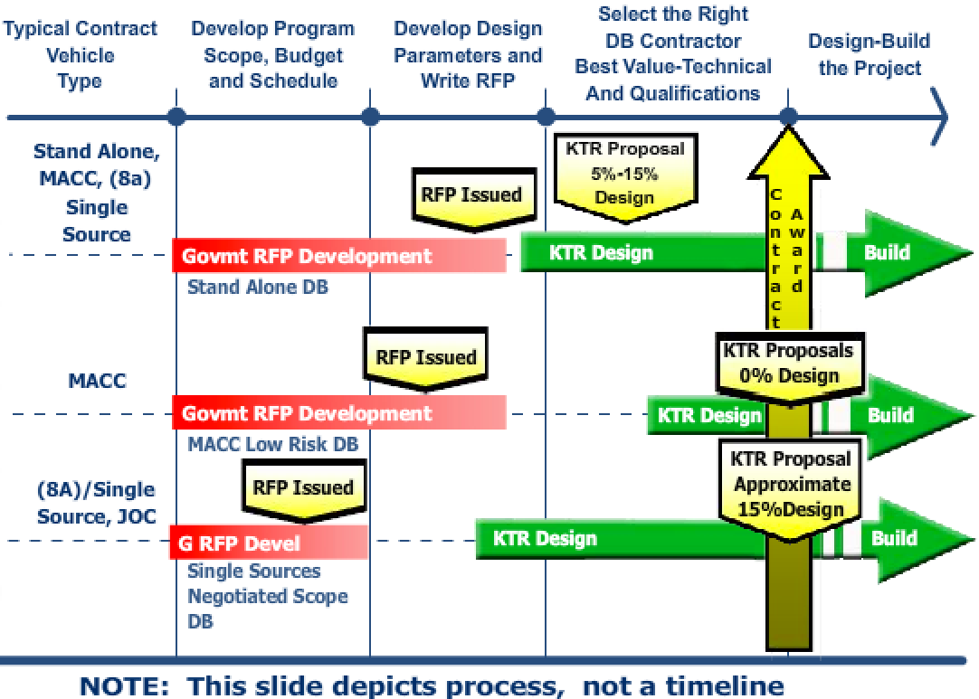
NAVFAC D-B Processes - Diagram
Notes:
This diagram outlines the phases of the different processes. At the top of the chart from left to right it goes through the phases from developing the program scope, budget and schedule through to the design and construction of the project by the design-build contractor. And the typical contract vehicles are shown along the left scale.
This shows you how much effort is required by the Government to develop an RFP based on the process used. For example, more effort is required with the Standalone and the MACC Contracts to develop the RFP than is required for the Single Source Contract. The Single Source process requires the least effort to develop an RFP because it ends up being a joint scoping effort with the Contractor. This will be further explained in a later slide.
This also shows that the RFP is issued earliest during Single Source, then later on a MACC Low Risk project, and then even later for Standalone and the traditional MACC projects.
Another thing to see here is how the Contractors are expected to participate prior to design. During the standalone and traditional MACC the Contractors are developing a concept design during the proposal phase, so you can see the design starting somewhat early; in the Single Source the Contractor starts even earlier in helping to confirm the scope and also performing additional information gathering. And then with the MACC Low Risk the Contractor does not submit a concept design during the proposal stage, so his design efforts start the latest of all of the processes.
It also shows the level of effort required by the Contractors in Designing the project, with more effort required in a Single Source and the least effort required in MACC Low Risk.
Again, all of this will be explained later in this training module as we go through the particulars on each of the processes

Slide 12

Knowledge Check #1
Notes:
Let’s answer a couple of questions on the material we’ve learned so far…

Slide 13
Knowledge Check #1
The RFP should be which of the following:
As performance-based as possible
Prescriptive-based, telling the Contractor how to accomplish the project
(True/False) The Government’s Technical Team should be comparing the design to the last successful project they worked on for this same facility type?
False. Should be comparing to the RFP requirements and the Contractor’s proposal.
Notes:
[Answer lines will be revealed using animation when audio-video versions are created]
Question number 1: The Design-Build RFP should be which of the following. “a”, as performance-based as possible, or “b”, prescriptive-based, telling the Contractor how to accomplish the project…
The answer is “a”, as performance-based as possible. Remember that in Design-Build the Contractor’s Designer of Record is the designer on the project, and they have the advantage of being able to collaborate with the entire Contractor team. Thus, in order to get the benefits of the Design-Build collaborative team, we need to tell the Contractor what we need, in a performance-based manner, but not how to accomplish it. We don’t want to unnecessarily restrict the Contractor in specifying the exact way to construct the project. This allows the Contractor to propose innovative solutions.
Question number 2, True or False: The Government’s Technical Team should be comparing the design to the last successful project they worked on for this same facility type…
The answer is “False”. There may be good reasons for the project requirements to be different from other similar projects; thus, the Technical Team must be comparing the Contractor’s design to the requirements stipulated in the project RFP and also to the Contractor’s proposal that was used as the basis for award.

Slide 14
BMS
Business Management System
Documents all NAVFAC processes
Web-Based tool accessible on NAVFAC Portal
BMS are continually being updated
Always a work-in-progress
Allows input for continuous improvement
Review regularly for updates to processes
Notes:
You can find the steps in each of the processes and much more in NAVFAC’s Business Management System, or “BMS”.
Most of you know that BMS is a system that outlines NAVFAC’s business processes and describes the work performed to deliver NAVFAC products and services. It includes associated resources and identifies roles and responsibilities for NAVFAC personnel.
BMS is web-based and is accessible through the NAVFAC portal. They are not accessible to non-Navy personnel.
BMS is designed to be continually updated so it should be reviewed regularly to determine if any processes have been updated

Slide 15
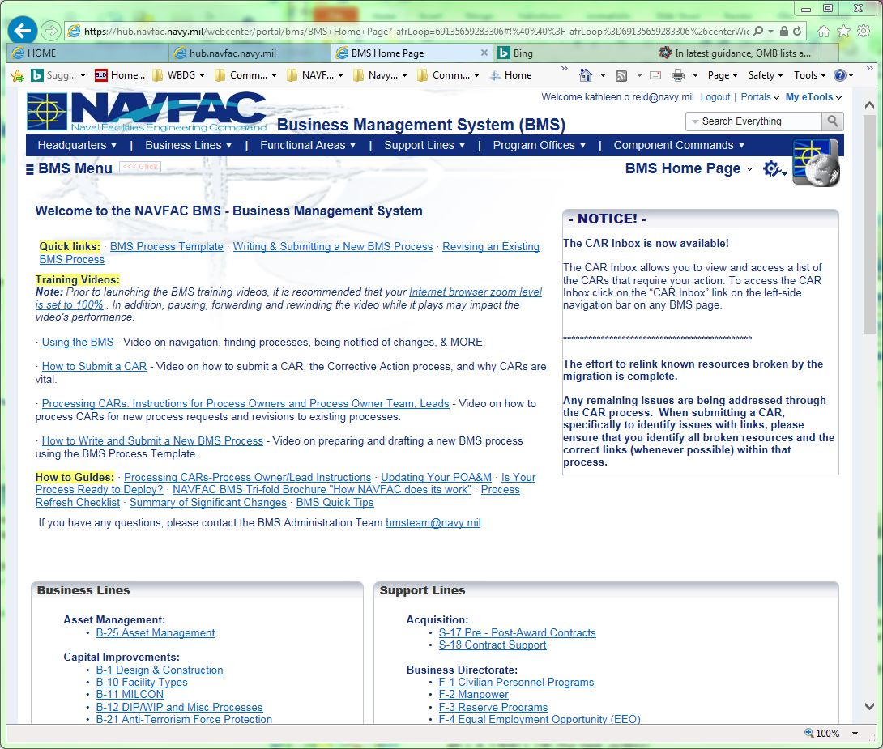
Design-Build and BMS
NAVFAC Employees Access BMS from the
NAVFAC Portal Intranet
Under “eTools”
BMS Home Page
Links to all Process Groups
Frequently Asked Questions
BMS Tutorial & Intro
How processes are organized
How to submit a CAR
Notes:
The BMS is accessed through the NAVFAC Portal Intranet. Unlike the Navy Design-Build Master that is housed on the public Whole Building Design Guide website, BMS is internal and not accessible to the public.
The Capital Improvement Section of BMS addresses several processes. B1 section of the BMS, titled “Design and Construction”, includes both Design-Bid-Build and Design-Build processes. Note that Capital Improvements has a specific page link.
The Acquisition Section of BMS that addresses the planning, award and administration of design and construction contracts is in BMS Section S-17.

Slide 16
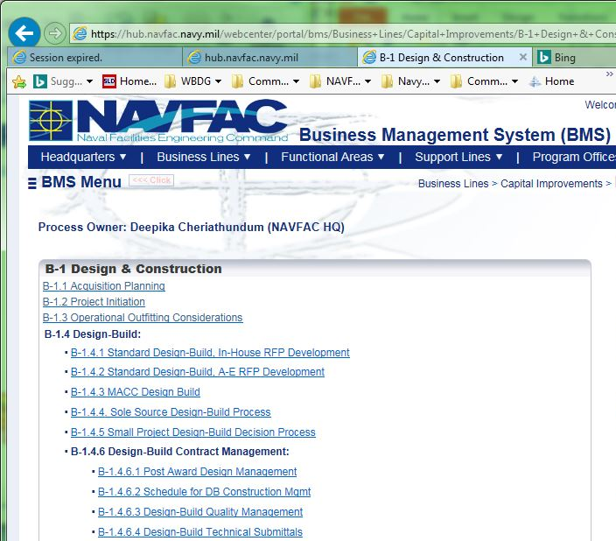
BMS DB Processes
DB B-1.4
DB B-1.4.1 thru B-1.4.6
Notes:
When you access a section anywhere within BMS, you’ll see a series of tabs across the top of the page that contain relevant information…Points of Contact; General Information; Flowcharts, etc.
In Section B-1, covering Design and Construction processes, there are seven discrete Chapters from Project Initiation thru Project Close-Out. Chapter B-1.4 is titled Design-Build.
Under B-1.4 you would see these processes:
B-1.4.1 “Standard Design-Build with In-House RFP Development”
B-1.4.2 “Standard Design-Build with A/E RFP Development”
B-1.4.3 “Multiple Award Construction Contract”, or MACC Design-Build (for task orders)
B-1.4.4 “Sole-Source Negotiated Scope”
B-1.4.5 “Small Project Design-Build Decision Process”, and
B-1.4.6 “Design-Build Construction Management”
Under 1.4.6 you will also see 3 sub-processes for construction management efforts that are unique to Design-Build.
Section S-17, under “Acquisition”, also has several chapters that relate to the planning, award and administration of contracts including design-build.

Slide 17
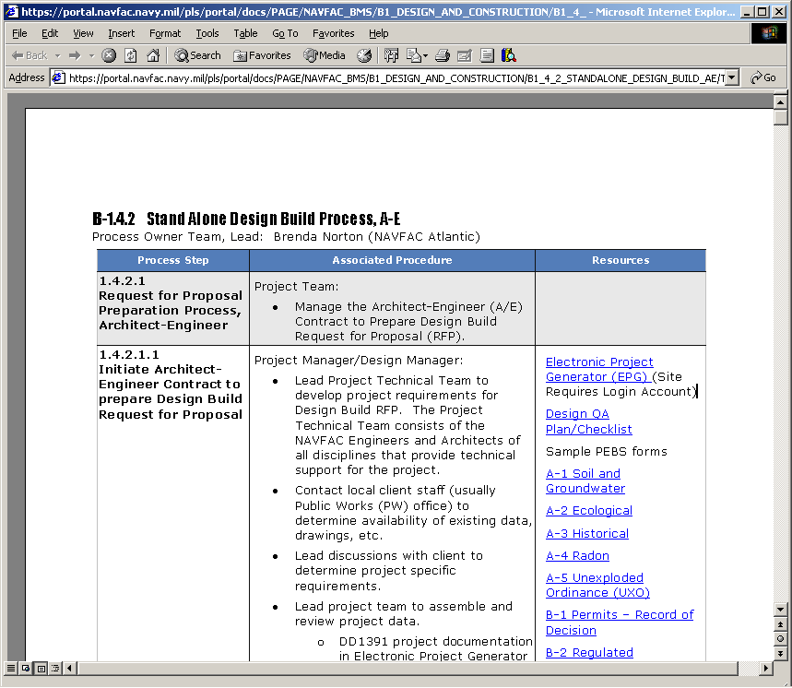
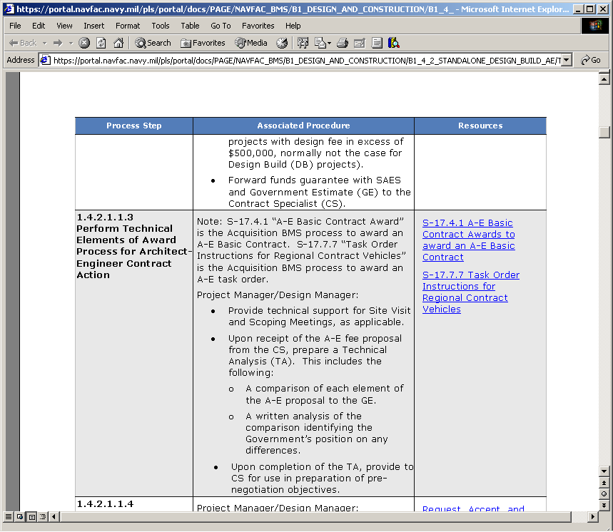
BMS Process Details
Process Details
Outlines “Roles and Responsibilities”
Full description of
“how to do the work”
Links to forms, templates,
checklists, laws, policies,
regulations, instructions,
web sites.
Cross-functional knowledge via inter-process links e.g., Financial Mgt, Acquisition.
Notes:
Here is an example of the detail in BMS :
BMS outlines the role and responsibility of a NAVFAC team member, describes the effort needed and how they should do the work, and conveniently provides links to resource documents and forms needed to complete the various tasks within the process steps.

Slide 18
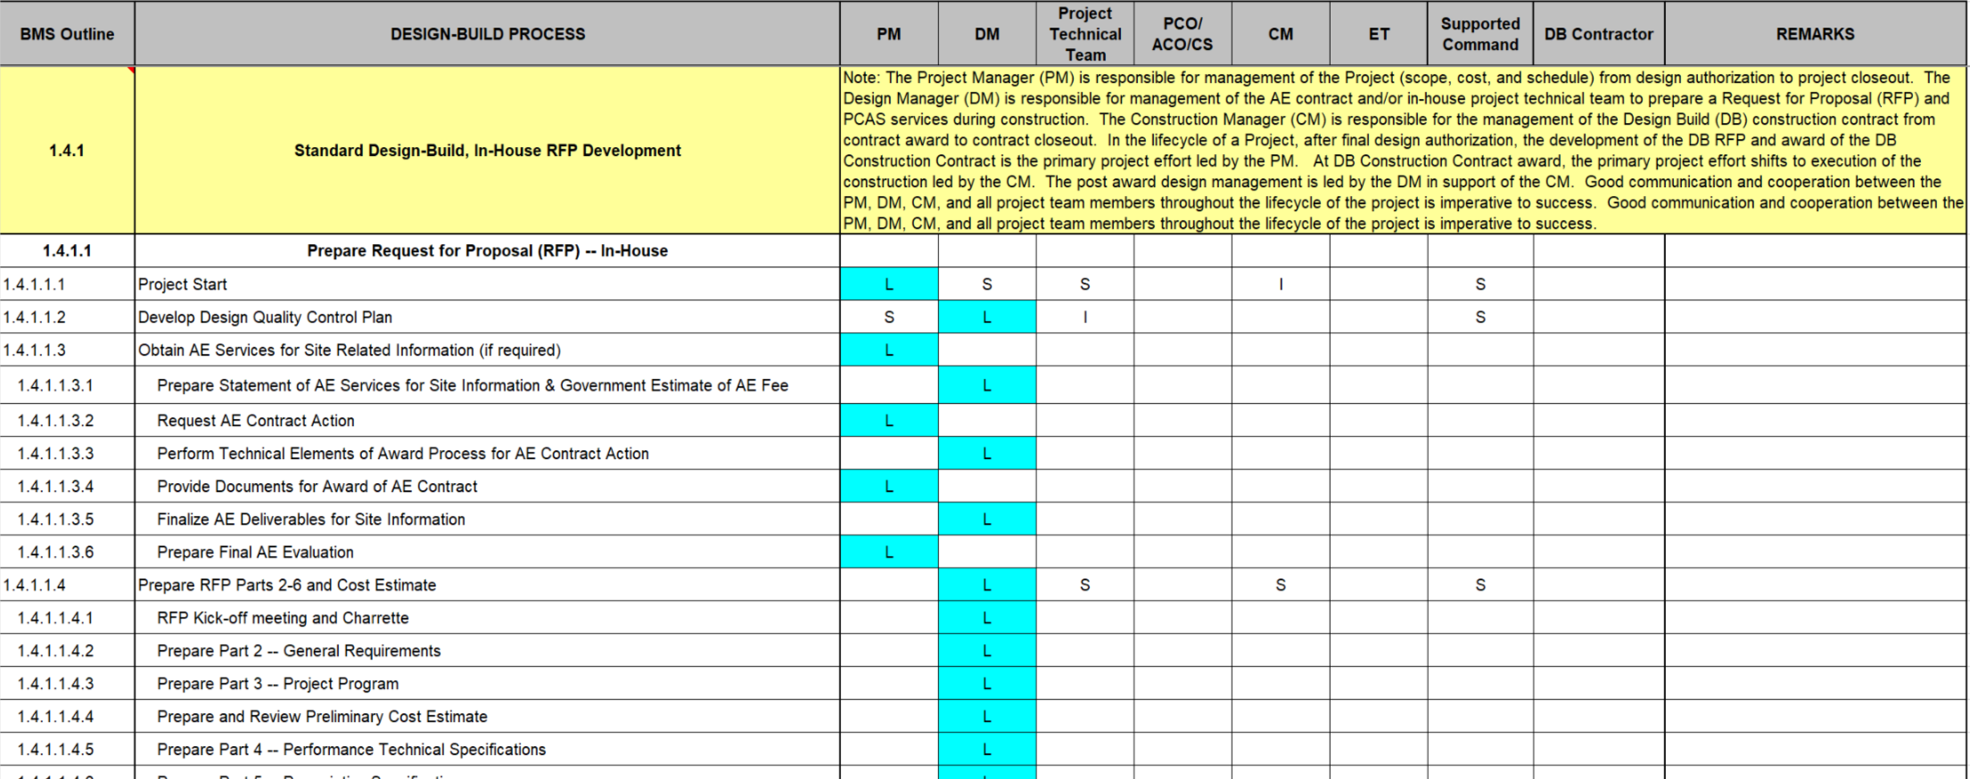
Design Build – Pre-Award Process
BMS Roles and Responsibilities Matrix unique to DB
Notes:
BMS covers the roles and responsibilities of NAVFAC personnel in the processes that are outlined. NAVFAC personnel, in their project roles as Project Manager, Design Manager, Construction Manager or Engineering Technicians may be shown as “Leading” a task, indicated with an “L”; “Supporting” a Task, indicated with an “S”, or providing “Input”, which is indicated with an “I”.
As seen in the matrix here, the project team includes the PM, CM, Contract Specialist (CS), DM, Project Technical Team, Supported Command, and others as appropriate.
The Project Technical Team is comprised of NAVFAC engineers and architects (from all disciplines) who provide technical support for the project.
The Roles and Responsibilities (R&R) Matrix is provided as a companion to assist in the project delivery process. It should not be used independently of the fully developed processes as outlined in the BMS’s.
These processes and associated roles and responsibilities have been developed to ensure successful project delivery and all NAVFAC personnel should be familiar with their expected responsibilities for each process in the design-build project approach.

Slide 19
Design Build – Processes Covered in BMS Sections
BMS Sections for Processes by Procurement Type:
Procurement Method | BMS Process Section
Standard Design-Build, In-House RFP Development | B-1.4.1
Standard Design-Build, A/E RFP Development | B-1.4.2
Multiple Award Construction Contract (MACC) Design-Build | B-1.4.3
Sole Source Design-Build | B-1.4.4
Small Project Design-Build | B-1.4.5
Notes:
This list shows the sections of the BMS that cover Design Build processes. These sections cover NAVFAC personnel’s roles and responsibilities for successful delivery of a design-build project, based on each procurement method.
Under B-1.4 you would see these processes:
B-1.4.1 covers Standard Design-Build with In-House RFP Development
B-1.4.2 covers Standard Design-Build with A/E RFP Development
B-1.4.3 outlines Multiple Award Construction Contract, or MACC Design-Build (for task orders)
B-1.4.4 covers processes for Single-Source Negotiated Scope, and
B-1.4.5 outlines the Small Project Design-Build Decision Process

Slide 20
Design Build – NAVFAC Personnel Roles
Roles and Responsibilities Matrix in BMS
Defines responsibilities for Government personnel on DB projects
Key NAVFAC Personnel
Project Manager – Responsible for management of project (scope, cost, and schedule) from design authorization to project closeout. Relinquishes project lead to CM after award
Design Manager – Manages A/E Contract, or in-house project team, for development of RFP and leads the review effort of DB Team’s design
Construction Manager – Leads project beginning at award through close-out
Engineering Technician – Provides quality assurance during construction with periodic reviews.
Notes:
This slide shows the general roles of NAVFAC personnel in the design-build project delivery process.
The Project Manager is the one with overall responsibility for management of the project all the way through closeout, although for some of the project sub-tasks one of the other NAVFAC team positions takes the “Lead” role in support of the PM.
The Design Manager, or DM, manages development of the RFP, whether through an in-house team or by an A/E Contract. The DM also coordinates or leads the review effort of the Design-Build Contractor Team’s design.
The Construction Manager, or CM, shifts into the “Lead” role in support of the PM beginning at contract award through project close-out.
NAVFAC Engineering Technicians, or ET’s, provide quality assurance during construction by performing periodic reviews.
Good communication and cooperation between the PM, DM, CM, and all project team members throughout the lifecycle of the project is critical to a design-build project’s success.

Slide 21
Knowledge Check #2
Notes:
Let’s answer a few more questions on the material we’ve learned so far…

Slide 22
Knowledge Check #2
The BMS Processes can be accessed from which of the following locations?
Whole Building Design Guide website
NAVFAC Portal
(True/False) NAVFAC’s Project Manager is only responsible for management of the project from design authorization until award to the DB Contractor, when the Construction Manager takes over?
False. The CM does take the lead role from award through close-out; however, the PM maintains responsibility for management through project closeout.
Notes:
[Answer lines will be revealed using animation when audio-video versions are created]
Question number 1: The NAVFAC Business Management System processes can be accessed from which of the following locations. “a”, the Whole Building Design Guide website, or “b”, the NAVFAC Portal…
The answer is “b”, NAVFAC employees access BMS from the NAVFAC Portal Intranet
Question number 2, True or False: NAVFAC’s Project Manager is only responsible for management of the project from design authorization until award to the DB Contractor, when the Construction Manager takes over…
The answer is “False”. Even though the CM takes the lead role from the point of award through construction closeout, the PM maintains responsibility for management, which includes project scope, cost and schedule.

Slide 23
Design-Build Processes
NAVFAC’s Design-Build processes:
Standard DB Process
Multiple Award Construction Contract (MACC) DB Process
Sole Source Negotiated Scope DB Process
Small Project DB Process
Notes:
Here’s a quick reminder that NAVFAC has four basic Design-Build Processes.
The four processes are:
Standard DB Process which can be used for all our projects although it is typically used in larger stand-alone contracts.
Multiple Award Construction Contract, or “MACC”, DB Process which is used for MACC task orders.
The Sole Source Negotiated Scope DB Process which is used with non-competitive contracts, and
The Small Project Design-Build Process which is used for small low risk projects.
The following slides describe each of these design-build delivery processes…

Slide 24
Standard D-B Processes
Processes outlined in BMS B-1.4.1 (for in-house RFP’s) and B-1.4.2 (for A/E developed RFP’s)
Utilizes a Stand alone Contract, not part of IDIQ or MACC
Versatile/Flexible Process
Uses 6-Part format from NAVFAC D-B Master Website
Utilizes Standard Template or a Model RFP
RFP scalable to project
Uses UFC Criteria for design requirements
“Contract to budget” amount or estimated construction cost may be provided in RFP
Uses 2-Phase Source Selection
Notes:
The Standard, or Standalone, Design-Build Processes are covered in BMS Sections B-1.4.1 and B-1.4.2, depending on whether the RFP is developed in-house or through use of an outside A/E firm.
The Standard Procurement Method:
Utilizes a standalone Contract, and is not a task order within an IDIQ Contract or a MACC
Second, it is a very versatile and flexible process, and can be used on any type of project and with any procurement method
It uses the standard 6-part RFP format from the NAVFAC D-B Master website; and utilizes either the standard template or one of the Model RFP’s
The RFP is “scalable”; for example, extra information may be needed in the Part 3 Project Program if it is a large complex project with many features; likewise, the RFP can be scaled down for very straightforward projects with fewer disciplines or trades involved
The standard RFP relies heavily on the Unified Facility Criteria, or UFC, documents for the project design requirements
The “Contract to budget” or estimated construction cost amount may be provided in the RFP on the proposal form in Part 1. If the RFP is in-depth with well-defined requirements, and the project type is repetitive, including the project budget amount may not be necessary. However, with a unique project with requirements that are more performance-based and where the teams have some leeway in their designs, it may make sense to include the project budget amount so that proposals are received within an amount that can be awarded. The decision to list the Contract to budget amount should be based on the project requirements and the MACC Contractor pool that is available; if the MACC Contractors have prior experience with the same type and size of project then the budget information is not as critical a piece of information.
And the standard processes utilize a 2-phase source selection process, with price and non-price technical factors used in evaluation and selection

Slide 25
MACC Processes
Multiple Award Construction Contract (MACC) Processes outlined in BMS B-1.4.3
RFP issued where a suitable MACC is in place
Uses same 6-Part format from NAVFAC D-B Master
Well-defined Project Program, Part 3
RFP may be developed in-house or by A/E
The Base MACC Contract establishes RFP Parts 1 and 2 (Divs 00 and 01); for follow-on task orders, Parts 1 and 2 are only edited for unique location and project requirements
“Contract to budget” amount or estimated construction cost may be provided in RFP
For a traditional MACC RFP, a concept design will be developed by the DB Teams and evaluated in selection
Notes:
The MACC Design-Build Processes are covered in BMS Section B-1.4.3. There is both a regular MACC RFP approach as well as one for projects deemed as “low risk”.
The MACC Processes are very similar to the standard processes, although it uses the MACC Contracts for source selection.
The MACC processes are only used where there is a suitable MACC in place, for example there may be a MACC for Bachelors Quarters or Dining Halls, and this may be the type of facility you need completed through Design-Build. You cannot use a D-B project using these processes to set up a new MACC, because this process does not use 2-phase source selection; it only uses 1-phase.
MACC uses the same 6-part format from the NAVFAC D-B Master
Because the MACC Contract will be based on certain facility types, the RFP used will have a well-defined Project Program with in-depth scope requirements for that facility type. This will be well-defined because you will be instructing Contractors that have been selected to construct these types of facilities.
RFP’s may be developed using in-house teams within NAVFAC or through use of an outside A/E firm
With these MACC Contracts, the “Base” contract will include Parts 1 and 2, which are the Division 0 and Division 1 sections of the RFP. Then, for follow-on task orders, only the portions of Parts 1 and 2 that are unique to the location or project requirements are included in the task order RFP.
As described for the standard RFP processes, the “Contract to budget” amount or estimated cost of construction may be included in the RFP
And finally, for a traditional MACC (not a low risk MACC) a concept design will be developed by the Design-Build teams and these will be evaluated for selection

Slide 26
“Low Risk” MACC Processes
Characteristics for “Low Risk” MACC
Prescriptive UFC Criteria (Bachelors Quarters, Dining Halls)
It is not considered a complex design
Facility is common to the private sector
If “Low Risk MACC”
RFP is scaled-down 6-part format
Right-sized, well-defined Part 3, Project Program
A concept design is not developed by the DB Teams for evaluation and selection
DB Teams submit narrative of key features explaining concept design and construction to demonstrate understanding of RFP requirements
Design solutions are developed post-award
Notes:
The MACC Design-Build Processes are covered in BMS Section B-1.4.3. There is both a regular MACC RFP approach as well as one for projects deemed as “low risk”.
A “low risk” MACC is utilized when there is prescriptive UFC criteria for the facility type, such as Bachelors Quarters and Dining Halls, and when the design is not considered complex.
If the project is appropriate to utilize the “Low Risk MACC” approach…
Then the RFP is a scaled-down version
Part 3 of the RFP, the Project Program, is right-sized and well-defined
Since prescriptive criteria is available for the facility type, then a concept design is not developed by the proposing teams
The DB teams primarily submit a narrative of the key features explaining the project design concept and construction approach to provide a demonstration of their understanding of the project requirements
Design solutions then get developed post-award

Slide 27
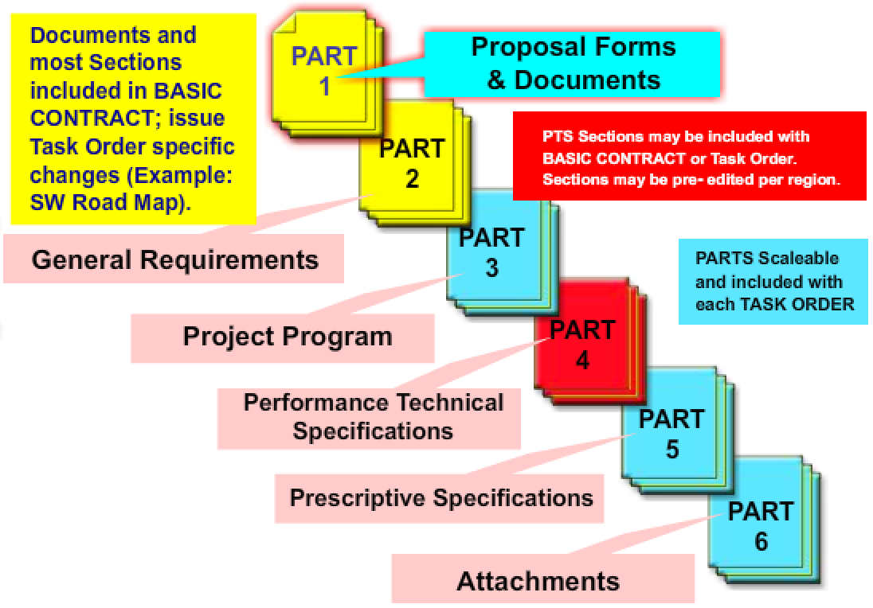
Layout of the MACC RFP Package
Notes:
[Graphic to be upgraded during development of upcoming audio-video version]
As mentioned in the previous slides, the MACC RFP Package is typically a scaled-down version of the standard RFP:
First, as described previously, Parts 1 and 2 are issued with the MACC Base Contract, so the Parts 1 and 2 of the project task order RFP would only include those requirements specific to the location or project unique requirements
Part 3 may be scaled back from a standard RFP if the project is a type that the entire MACC Contractor pool has experience with constructing.
Also, if the project is a common facility type then Part 4 for this project type may also have been included in the Base Contract. This would obviously need to be confirmed before Part 4 is omitted.
It is important to remember that most project types included within MACC contracts have well-established criteria documents such as UFC’s. If this is the case, the RFP can be scaled back from the typical amount of information in an RFP.

Slide 28
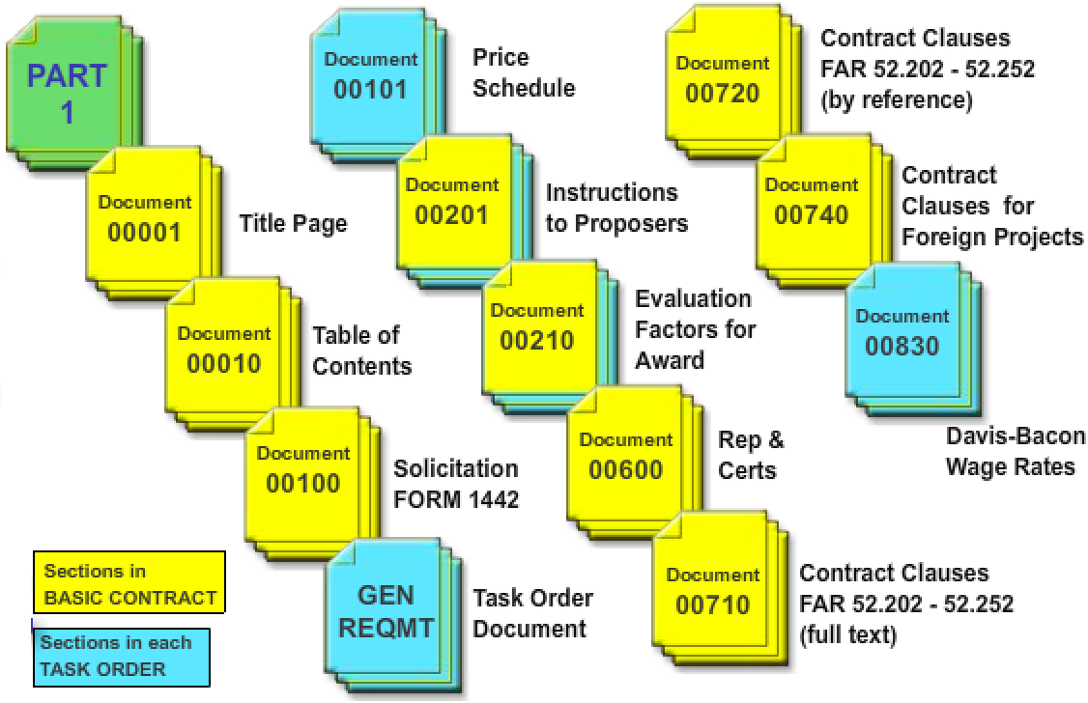
Layout of the MACC Part 1
Notes:
[Graphic to be upgraded during development of upcoming audio-video version]
As mentioned in the prior slides, Part 1 for a MACC Contract is typically scaled back because many of the standard Division 0 sections are included in the MACC’s Base Contract. This will need to be checked to determine what will need to be added for the task order RFP.
Information does not need to be repeated in each task order.
This slide shows the typical layout of a Part 1 section for a MACC RFP. The sections in yellow are typically in the Base Contract and those in blue will typically be customized for each project task order.

Slide 29
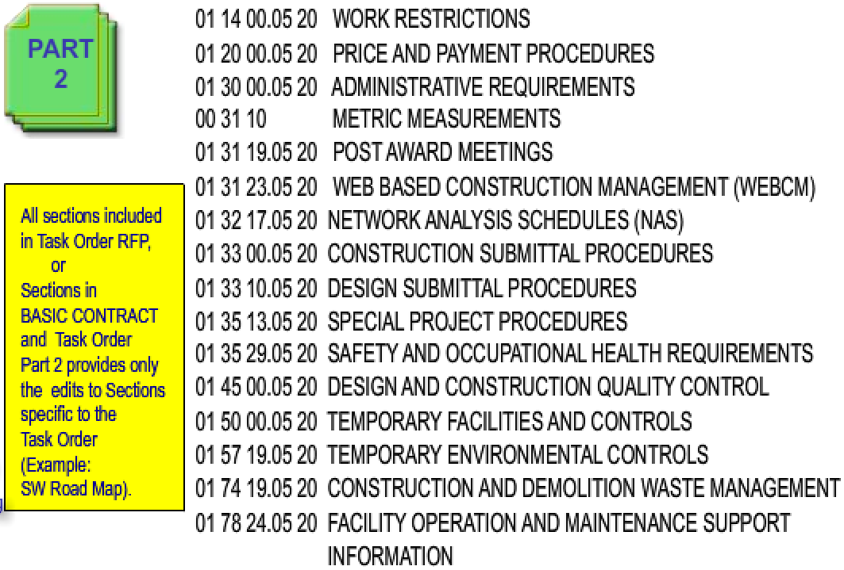
Layout of the MACC Part 2
Notes:
[Graphic to be upgraded during development of upcoming audio-video version]
This slide shows the sections in Part 2 of a MACC RFP. Again, the Base Contract will need to be reviewed to determine what needs to be included in each task order RFP. All of these may need to be included in the task order, or most of these sections may be included in the Base Contract and Part 2 of the task order would only need to include edits to the Sections specific to the task order, such as access road or gate requirements, security access information, etcetera.

Slide 30
Sole Source Processes
Sole Source Contract Processes in BMS B-1.4.4
Used with 8(a) Contractors for projects < $3.5 Million; follow BMS S-17.2.17 for Acquisition
Ensure project matches the Contractor’s skills
Allows for open discussions with Contractor prior to award
Uses the 6-part RFP format
Uses a scaled-down Project Program, Part 3
If not provided in Part 6 of the RFP, a concept design will be developed by the Contractor
Existing information is provided in the RFP; Government typically does not perform additional testing. Contractor, during the proposal phase, collects any additional information needed
Notes:
The Sole Source Design-Build Processes are covered in BMS Section B-1.4.4.
The Sole Source processes are used with 8(a) Contractors and on projects less than $3.5 Million. BMS section S-17.2.17 outlines the acquisition procedures for Sole Source; these thresholds change periodically so this BMS should be reviewed for the latest project value threshold
When selecting the Contractor, make sure their skills and past experience is appropriate for the project
This method allows for open and unlimited discussions with the Contractor prior to award; this is very different from the other Contracting methods in Design-Build
The RFP uses the traditional NAVFAC 6-part format; however, the Project Program in Part 3 can be scaled-down, because discussions are held to confirm the scope, and…
If a concept design is not included in Part 6 of the RFP, then the Contractor will submit a concept design in which the proposed scope can be confirmed.
One important distinction in the Sole Source process is that existing site and project information is collected and provided in the RFP; but for this process, the Government typically does not perform any additional testing. The contractor, during the proposal phase, will be allowed to further collect information such as topographic survey or geotechnical evaluations required as necessary to develop proposal costs. After award, the contractor will then perform testing necessary to comply with Unified Facilities Criteria (UFC) requirements.

Slide 31
Sole Source Processes
Sole Source Contract Processes (cont’d)
Scope is refined through open discussions and meetings with clients and Contractor
“Contract to budget” amount or estimated construction cost may be provided to the Contractor
Contractor’s proposal will include a concept design and proposed price, evaluated before award
Government develops Cost Estimate independent of Contractor
Post-award – parties continue to review and refine project details during design phase after award
Notes:
Looking at additional characteristics of the Sole Source Negotiated processes…
Through the open discussions and meetings that take place between the client and Contractor in the Sole Source Process, the project scope becomes more refined
Similar to other methods, the “Contract to budget” amount or estimated cost of construction may be included in the RFP
The Contractor’s proposal will include a concept design, typically to about 15% completion of design, as well as a proposed price. These will be evaluated before award. Any features in the concept design can be discussed during negotiations prior to making any award. Much of the discussions during negotiations will center on confirmation of the scope as required by the Government and the client.
Part of the process involves the Government developing a Cost Estimate independent of the Contractor. This will be our means of identifying those areas during negotiations that may be causing the differential in the pricing.
Remember that the design concept, and the resulting contract award, was based on approximately a 15% design completion. Thus, after the award, the parties continue discussions to work through many of the details involved in refining the project specifics

Slide 32
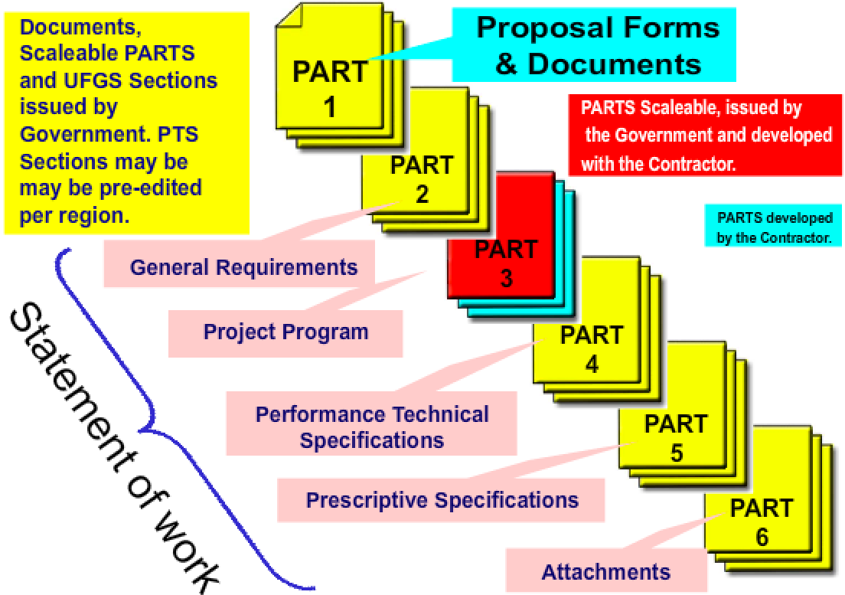
Sole Source Negotiated Scope – RFP Layout
Notes:
[Graphic to be upgraded during development of upcoming audio-video version]
The Sole Source RFP’s use the complete 6-part format
As seen here, Part 3 is in “red” because it is typically scaled back, and this is due to this process involving fully defining the scope through the joint scoping effort during meetings and discussions with the Contractor
Part 4 will be included and edited the same as in other processes
Part 5, the prescriptive specifications, should be minimal and used only to define critical and complex or unique project systems, such as a specialized security system
In Part 6 you’ll want to include any site or existing building information that is available, so that negotiations are not bogged down with the need to retrieve information that the Government has available

Slide 33
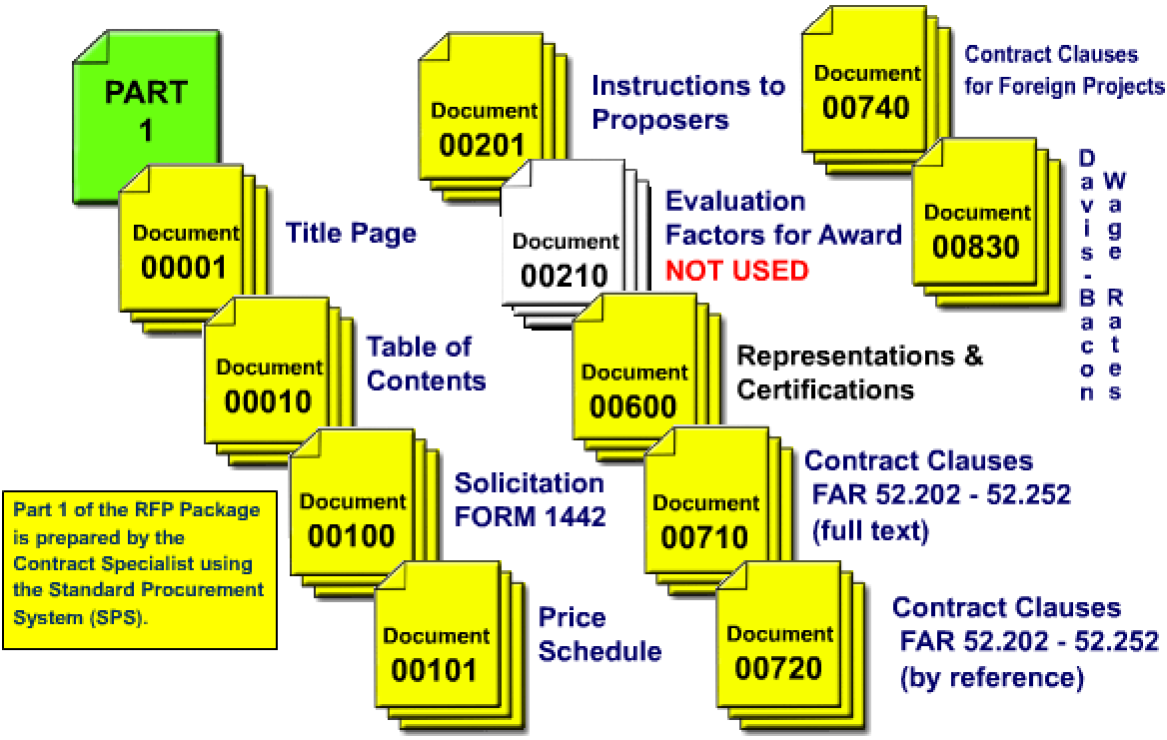
Layout of the Sole Source Part 1
Notes:
[Graphic to be upgraded during development of upcoming audio-video version]
Let’s look at the Part 1 of the RFP for a Sole Source project…the Part 1 is developed by the Contract Specialist.
It is important to note that the Evaluation Factors are not used; this is because the Contractor selection is more informal for a Sole Source project, and this will be described a little bit later in this presentation

Slide 34
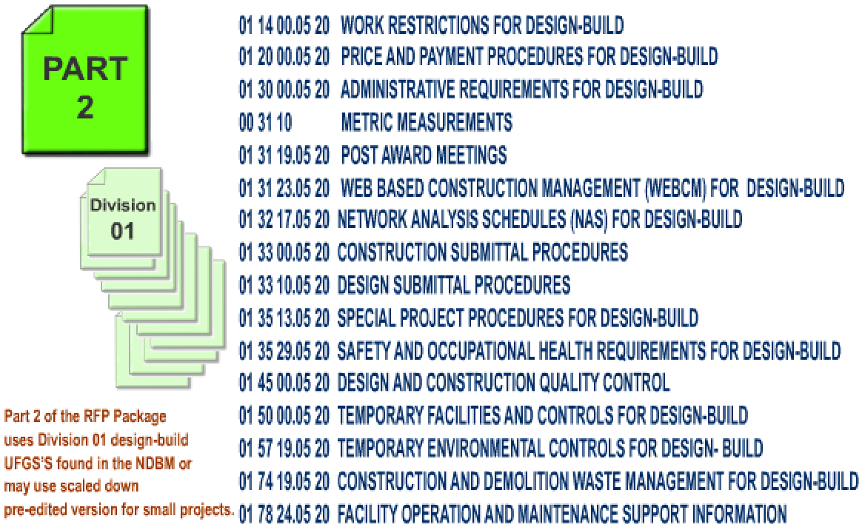
Layout of the Sole Source Part 2
Notes:
[Graphic to be upgraded during development of upcoming audio-video version]
This slide shows the sections in Part 2 of a Sole Source RFP. These are the typical General Requirements that you see in your standard RFP’s.
This is prepared with input from the local ROICC office, because this is where we would include any Base requirements such as work hour restrictions, Base security and access requirements, Badging requirements, etc

Slide 35
Sole Source Selection Process
For Sole Source selections, follow BMS S-17.2.17
Selection Process
Informal process
Coordinated with Small Business Specialist
Search Construction Contractor Register (CCR)
Match Contractor with project
Capabilities evaluation – check key personnel
Validate past performance with FEAD/ROICC and CPARS
Typical Considerations
Past performance
Past experience –key personnel
Management approach (emphasizes integrated team)
Notes:
BMS section S-17.2.17 outlines the acquisition procedures for Sole Source
The Selection Process is more informal than other processes, however we must still take care in selecting the right Contractor in order to have a successful design-build project
The first thing you want to do is coordinate with the Small Business Specialist
One of the sources for information to identify potential Contractors is the Construction Contractor Register, or the “CCR”; this is a Small Business Administration web-enabled tool that can be searched to locate the Contractors in a particular area; another good source of information is the ROICC office at the Bases in the area – they typically know who the good Contractors are that have worked on their projects; this list of potential Contractors should be maintained somewhere so that it can be referenced for future projects also
We want to make sure that we match the Contractor with the project…
One of the ways we do that is with a capabilities presentation. A Contractor can be brought in and asked what their experience is on design-build, what is their experience on a particular type of project, and who they might collaborate with on a particular type of project. You need to be careful not to identify the specific project when having these discussions. You are simply trying to get an understanding of their capabilities to determine if they are a good fit for the project. This would involve them having the right people, right experience, and right subs to be able to deliver a successful project
The next thing is to validate past performance by first checking the CPARS system for Contractor evaluations. The CPARS system may not have a lot of information on these smaller Contractors, but you also can talk to the ROICC Office where they might have performed projects for previously. This is an informal process but we need to do our due diligence on identifying the right Contractor.
The typical considerations on selecting the right Contractor include their past performance of the firm, past experience of their key personnel, and their management approach to projects – one thing to focus on here is that they emphasize working with an integrated and collaborative team.

Slide 36
Small Project Design Guidance
Category of Work | Typical Contract Value | Use Small Project Process | Small Project DB Process Suitable for:
I | Any | No | ---
II | > $4M | No* | ---
 | $750K - $4M | Probably (if project meets listed suitability & requirements for SPDB) | Low-complexity, limited construction trade projects requiring routine designs with limited plans & specifications. Routine construction practices with low schedule risk. Typical types of projects include: Single-design discipline projects such as roof replacements, HVAC replacements, small pump houses, utility enclosures
 | < $750K | Yes | Non-complex
III | Category III work requires no design and is not design-build
IV | Category IV work requires no engineering or design and is not design-build
Notes:
The Small Project Process and RFP Template is not appropriate for all projects. Decision Guidance for use of the Small Project Design-Build Process (SPDB) is contained within Engineering & Construction Bulletin 2006-04 and the NAVFAC Business Management System section B-1.4.5.
Category II projects are typically suitable for use of Small Project Design-Build and these include Single-design discipline projects such as roof replacements, HVAC replacements, small pump houses, utility enclosures and other similar projects.
It is important to note that Small Project Design-Build may be suitable for projects that exceed $4 Million, by exception, when the work is straight-forward, and single trade, such as roadwork and roofing.
The Small Project D-B Process utilizes the Small Project Template which is a simplified RFP version. There is a separate training module dedicated to the characteristics and use of the Small Project RFP Template.

Slide 37
Design Build – Post Award Process
References:
BMS B-1.4.6.1 Post Award Design Management
BMS B-1.4.6.2 Schedule for DB Management
BMS B-1.4.6.3 Design Build Quality Management
BMS B-1.4.6.4 Design Build Technical Submittals
Notes:
This list shows the sub-sections of BMS section B-1.4.6 that cover Post-award processes specifically for Design Build. These sections cover NAVFAC personnel’s roles and responsibilities during the design phase, construction phase and all aspects for successful delivery of a design-build project.

Slide 38
Design Build – Post-Award Process
Roles and Responsibilities Matrix in BMS
Defines responsibilities for Government personnel on DB projects
Key NAVFAC Personnel – Post-Award
Construction Manager – Leads project beginning at award through close-out
Project Manager – Responsible for management of project (scope, cost, and schedule) from design authorization to project closeout. Relinquishes project lead to CM after award
Design Manager – leads the review effort of DB Team’s design
Engineering Technician – Provides quality assurance during construction with periodic reviews.
See BMS B-1.4.6 for Post-Award Processes
Notes:
This slide shows the general roles of NAVFAC personnel in the post-award phase. The roles of the CM and the PM shift after the award to the DB Contractor. While the PM is still the one with overall responsibility for the project all the way through closeout, at project award, the CM shifts into the “Lead” role in support of the PM. The post award design management is led by the Design Manager in support of the CM.
Good communication and cooperation between the PM, DM, CM, and all project team members throughout the lifecycle of the project is critical to a design-build project’s success.
The BMS sub-sections within section B-1.4.6, as listed on the prior slide, cover these post-award processes in great detail.

Slide 39
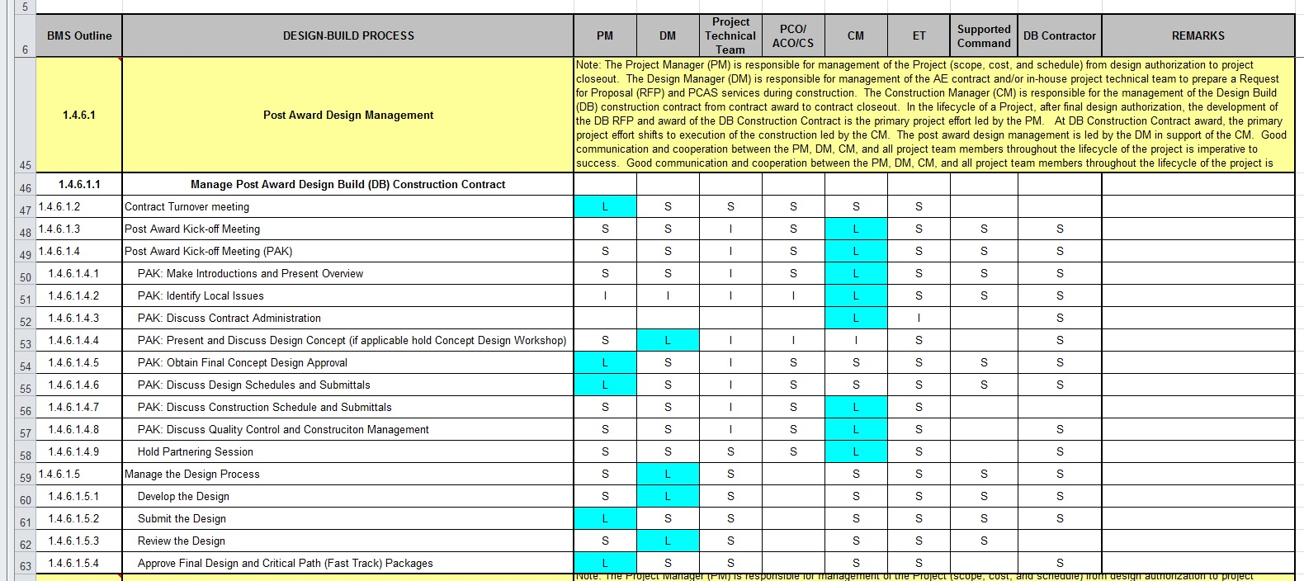
Design Build - Post Award Process
BMS Roles and Responsibilities Matrix unique to DB
Notes:
Similar to the Roles and Responsibilities Matrix for Pre-Award Processes, BMS B-1.4.6 covers the roles and responsibilities of NAVFAC personnel in the Post-award processes that are outlined. And once again, NAVFAC personnel, in their project roles as Project Manager, Design Manager, Construction Manager or Engineering Technicians may be shown as “Leading” a task, indicated with an “L”; “Supporting” a Task, indicated with an “S”, or providing “Input”, which is indicated with an “I”.
As a reminder, these processes and associated roles and responsibilities have been developed to ensure successful project delivery and all NAVFAC personnel should be familiar with their expected responsibilities for each process in the design-build project approach.

Slide 40
Final Knowledge Check
Notes:
Let’s answer a few final questions on the material we’ve learned in this module…

Slide 41
Final Knowledge Check
(True/False) There are separate BMS processes for Standard RFP’s developed In-house vs. those developed by A/E firms.
True. BMS B-1.4.1 covers processes when RFP’s are developed in-house and B-1.4.2 outlines processes when RFP’s are developed by A/E’s.
NAVFAC has how many basic Design-Build processes?
Answer: 4. These include:
a. Standard
b. MACC
c. Sole Source Negotiated
d. Small Project
Notes:
[Answer lines will be revealed using animation when audio-video versions are created]
Question number 1, True or False: There are separate Business Management System processes for Standard RFP’s developed In-house vs. those developed by A/E firms…
The answer is “True”, BMS B-1.4.1 covers processes when RFP’s are developed in-house and B-1.4.2 outlines processes when RFP’s are developed by A/E firms.
Question number 2: NAVFAC has how many basic Design-Build processes?
The answer is “4”. These include the Standard Design-Build process; the Multiple Award Construction Contract, or “MACC” process; the Sole Source Negotiated Design-Build process; and the Small Project Design-Build process.

Slide 42
Final Knowledge Check (cont’d)
(True/False) All NAVFAC Design-Build RFP’s use a 6-Part format.
True. Regardless of the Design-Build process being used, all NAVFAC RFP’s use a 6-Part format.
(True/False) The Small Project process and RFP template can be used for any project provided it is edited appropriately.
False. There is decision guidance in ECB 2006-04 and BMS B-1.4.5 for when Small Project process and RFP is appropriate for a project.
Notes:
[Answer lines will be revealed using animation when audio-video versions are created]
Question number 3, True or False: All NAVFAC Design-Build RFP’s use a 6-Part format.…
The answer is “True”, Regardless of the Design-Build process being used, all NAVFAC RFP’s use a 6-Part format.
Question number 4, True or False: The Small Project process and RFP template can be used for any project provided it is edited appropriately
The answer is “False”. Use of the Small Project process and RFP template is only appropriate for projects that meet certain parameters, with the primary criteria being cost and complexity. There is decision guidance in Engineering and Construction Bulletin 2006-04 and BMS B-1.4.5 for when the Small Project process and RFP is appropriate for a project.

Slide 43

Review of Learning Objectives
Today you have learned:
Commonalities of 4 D-B Processes
D-B Team Make-up
NAVFAC Business Management System
BMS Roles and Responsibilities
Characteristics of 4 D-B Processes
Post-award Processes
Notes:
In this training module we learned about.
The Commonalities and Common Objectives of the 4 NAVFAC Design-Build Processes
The Make-up of the Design-Build Team
The NAVFAC Business Management System
The NAVFAC personnel Roles and Responsibilities as outlined in the BMS
Characteristics of the 4 NAVFAC Design-Build Processes, and
The Post-award Processes

Slide 44

Design-Build Training Modules
Introduction to Design Build
Standard RFP Template
Design-Build Processes
Small Project Design-Build
D-B Master Management Training for Criteria Managers
Notes:
As we wrap-up today, just a reminder that there are 5 Design-Build training modules in this series. These include:
Introduction to Design-Build
Standard RFP Template
Design-Build Processes
Small Project Design-Build, and
D-B Master Management Training for Criteria Managers
I encourage you to view all of the modules. This will give you an in-depth understanding of the entire NAVFAC Design-Build Process.

Slide 45


Conclusion
Resource link:
Access BMS from the NAVFAC Portal Intranet Under “eTools”
https://hub.navfac.navy.mil/webcenter/portal/bms
Points of contact:
Kate Reid, RA, DBIA
NAVFAC Atlantic
kathleen.o.reid@navy.mil
Notes:
I hope this training module provided you with a greater understanding of the NAVFAC Design-Build Processes. NAVFAC employees can access the BMS processes from the NAVFAC Portal intranet system under the “eTools”.
Should you have any questions please contact the name shown on the screen.
Thank you for your time.

